Slide 1


Figure 1
HMMER
ClustalO
Phylo Trees
NCBI/JGI
BLAST
Dataframe
Results
BUSCO
DIAMOND
Graphs
Primary
Literature

Slide 2
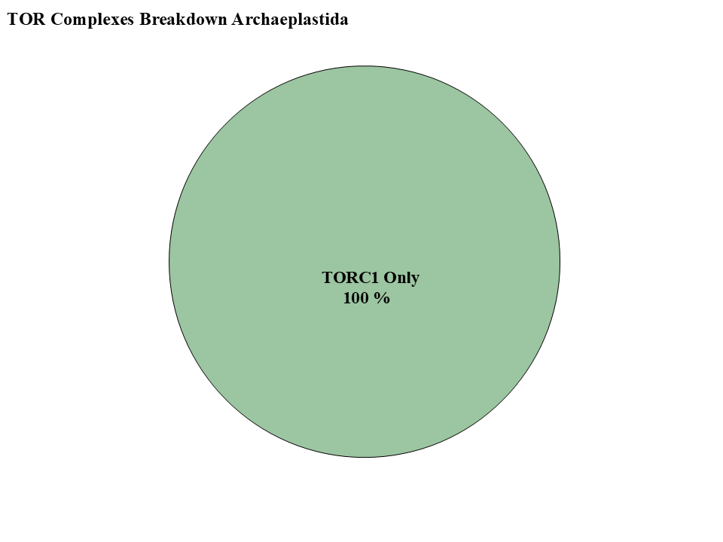
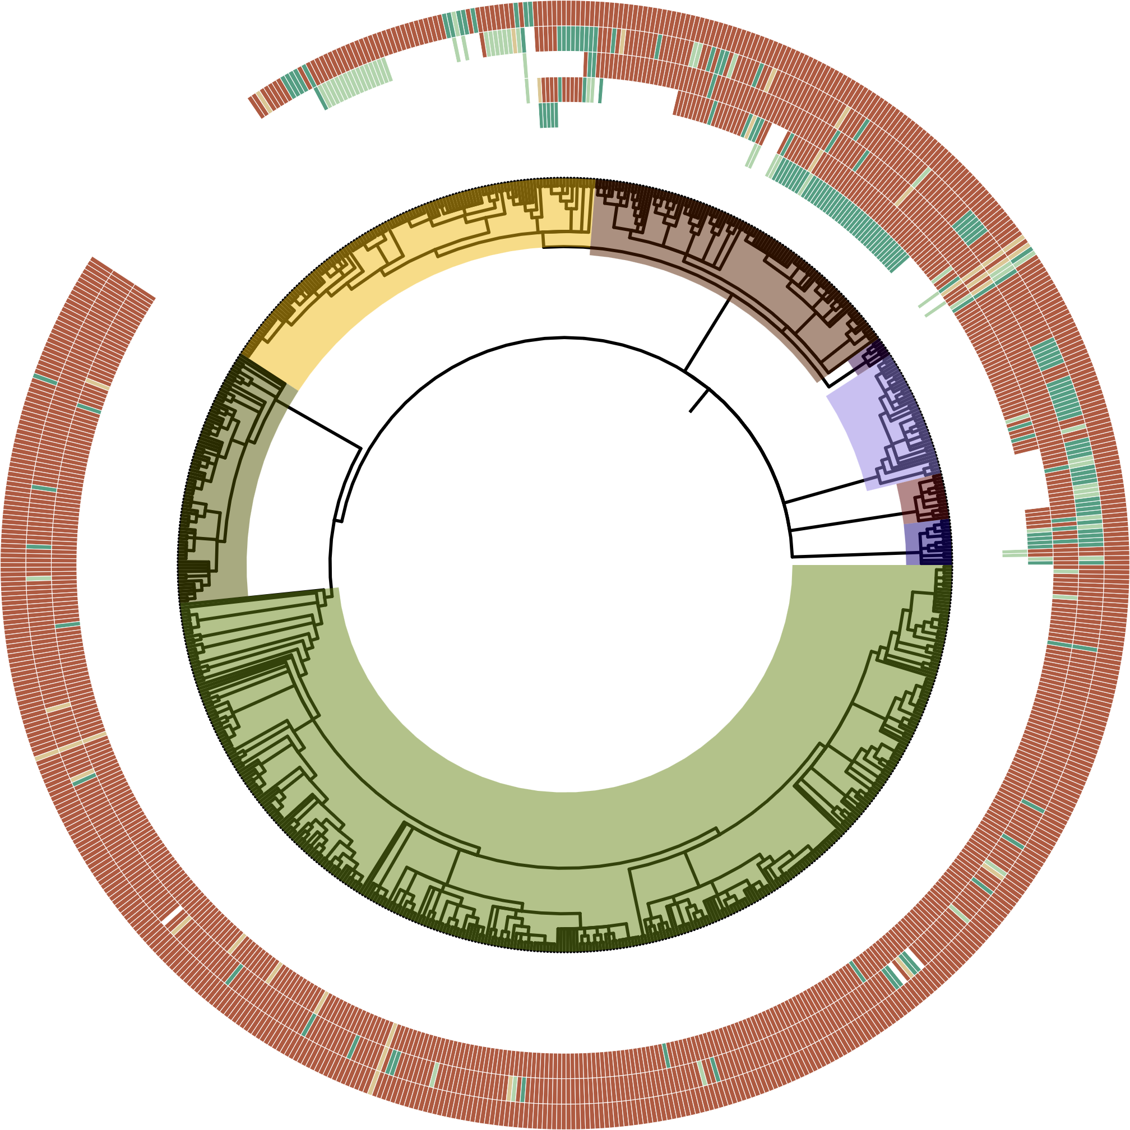
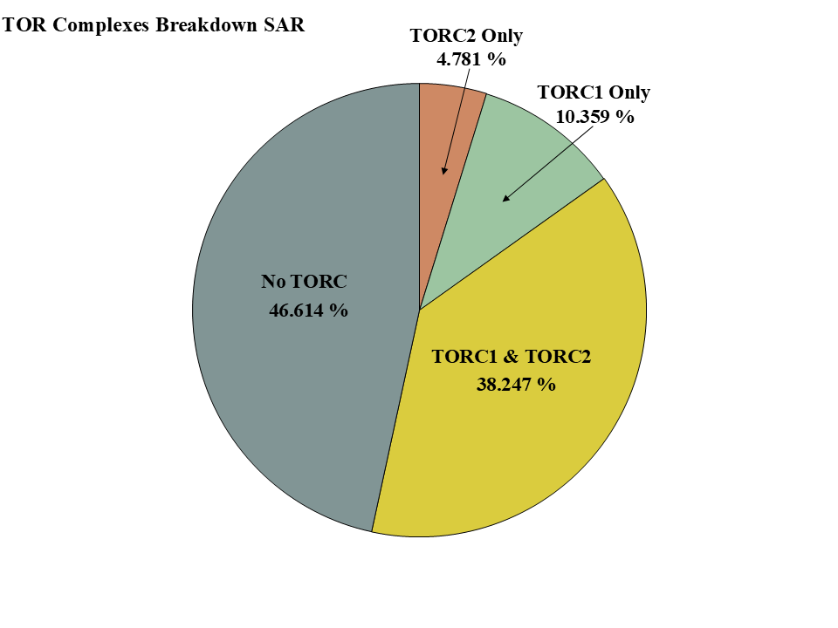
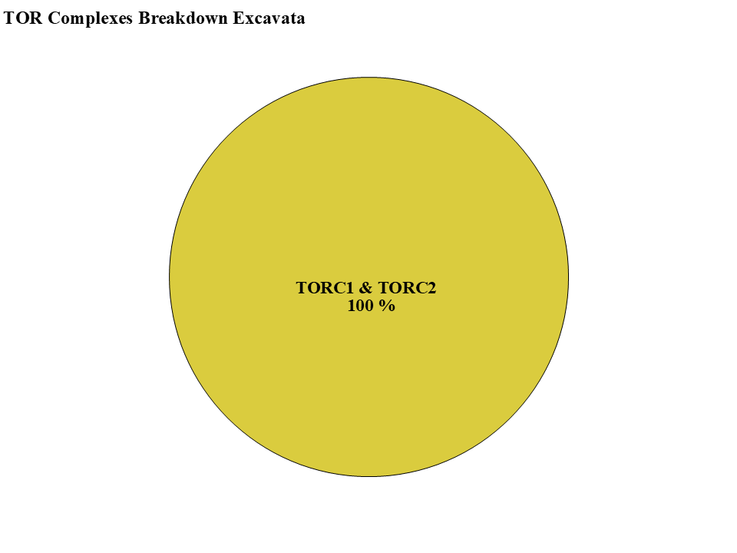
Figure 2
HMMER Score
-TOR-
-LST8-
H
-RAPTOR-
-RICTOR-
-SIN1-
M
L
P
ABS
Clade
Alveolata
Stramenopiles
Rhizaria
Streptophyta
Chlorophyta
Rhodophyta
Discoba
Metamonada

Slide 3
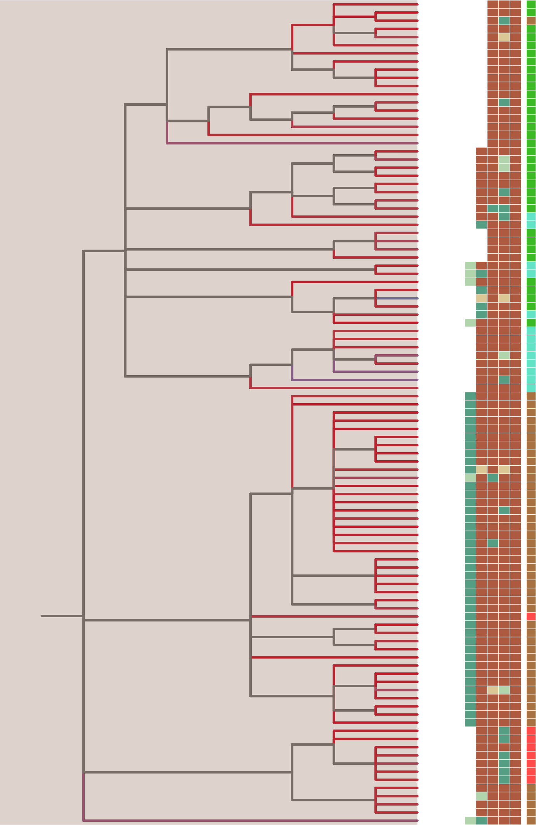
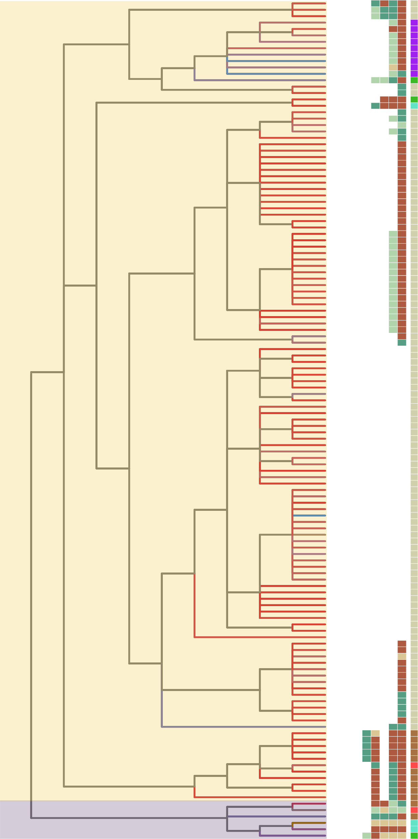
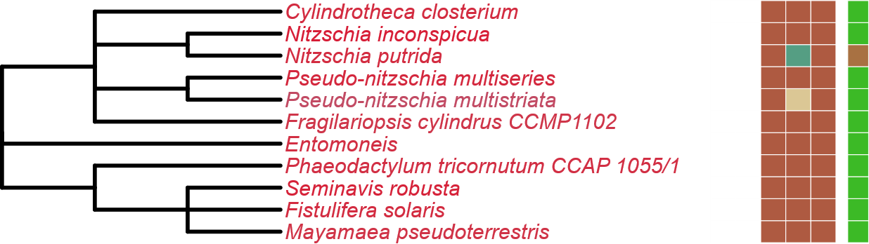
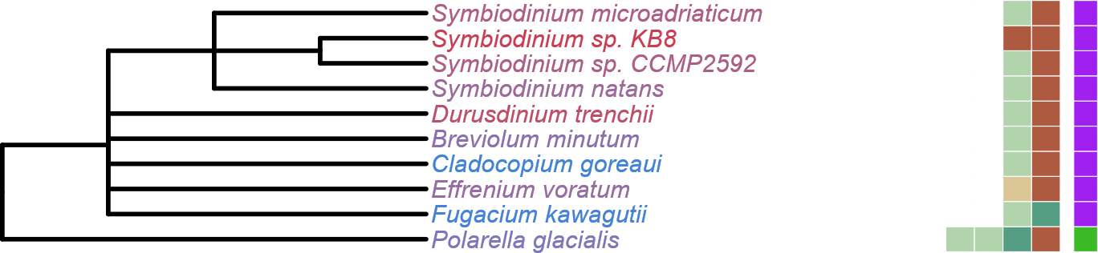

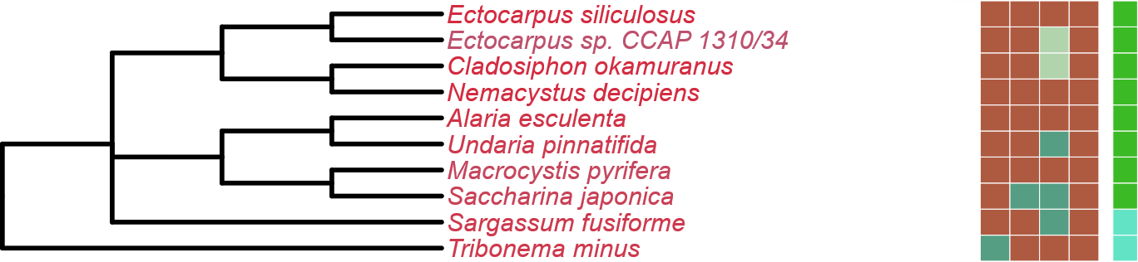



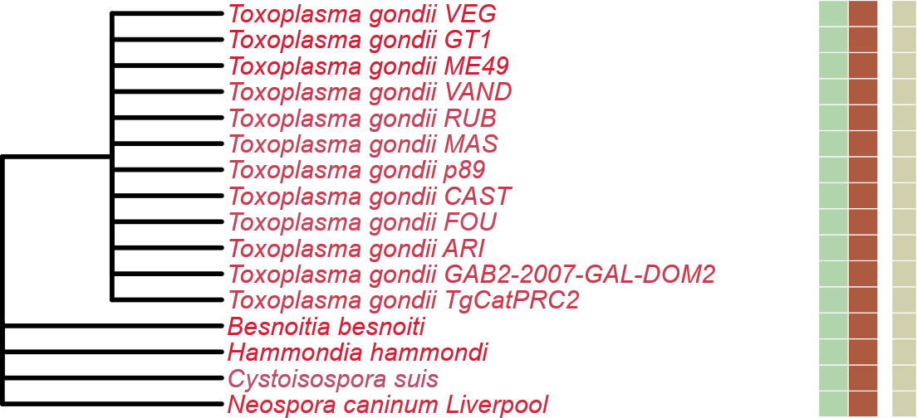
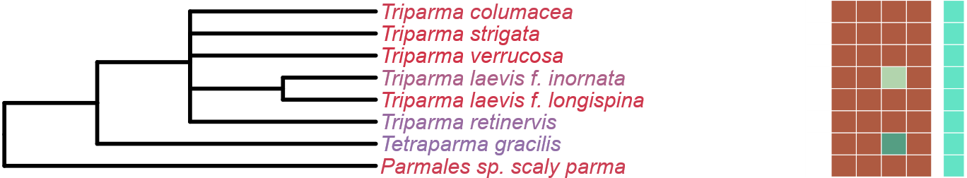
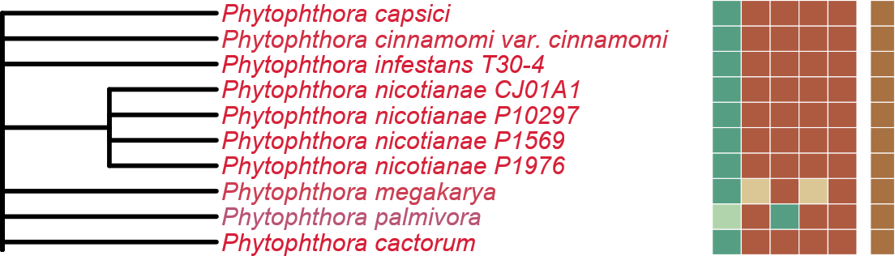
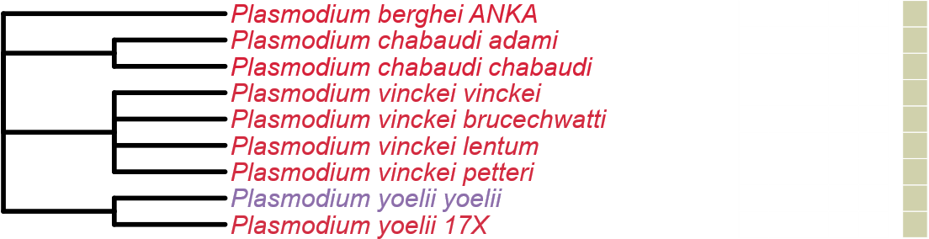
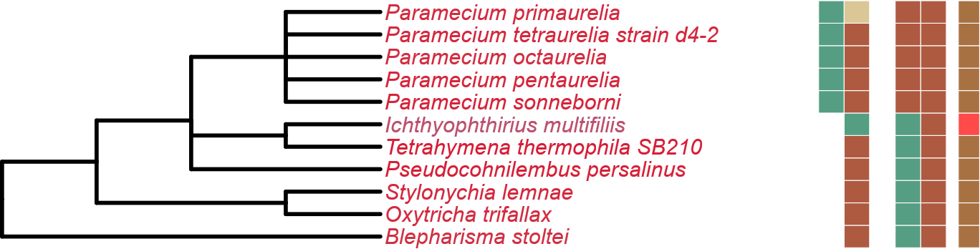
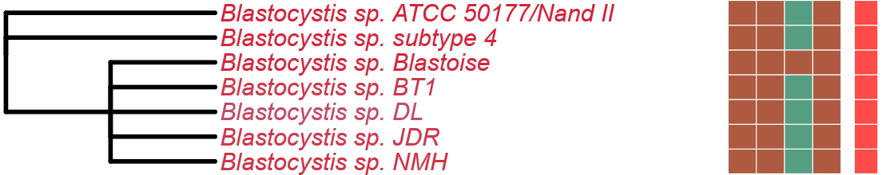
Figure 3
LST8
RICTOR
RAPTOR
TOR
LST8
RICTOR
RAPTOR
SIN1
SIN1
TOR
Completeness Score
Alveolata
100
Stramenopiles
75
50
25
HMMER Score
H
M
L
P
ABS
Metabolic Strategy
Autotrophic
Heterotroph
Mixotroph
Plastid Parasite
Non-Plastid Parasite
Endosymbiotic
Notes:
Updated Version of the SAR Tree divided between Stramenopiles/Alveolata. Trying to Emphasize the areas of TORC loss (both 1 and 2)

Slide 4
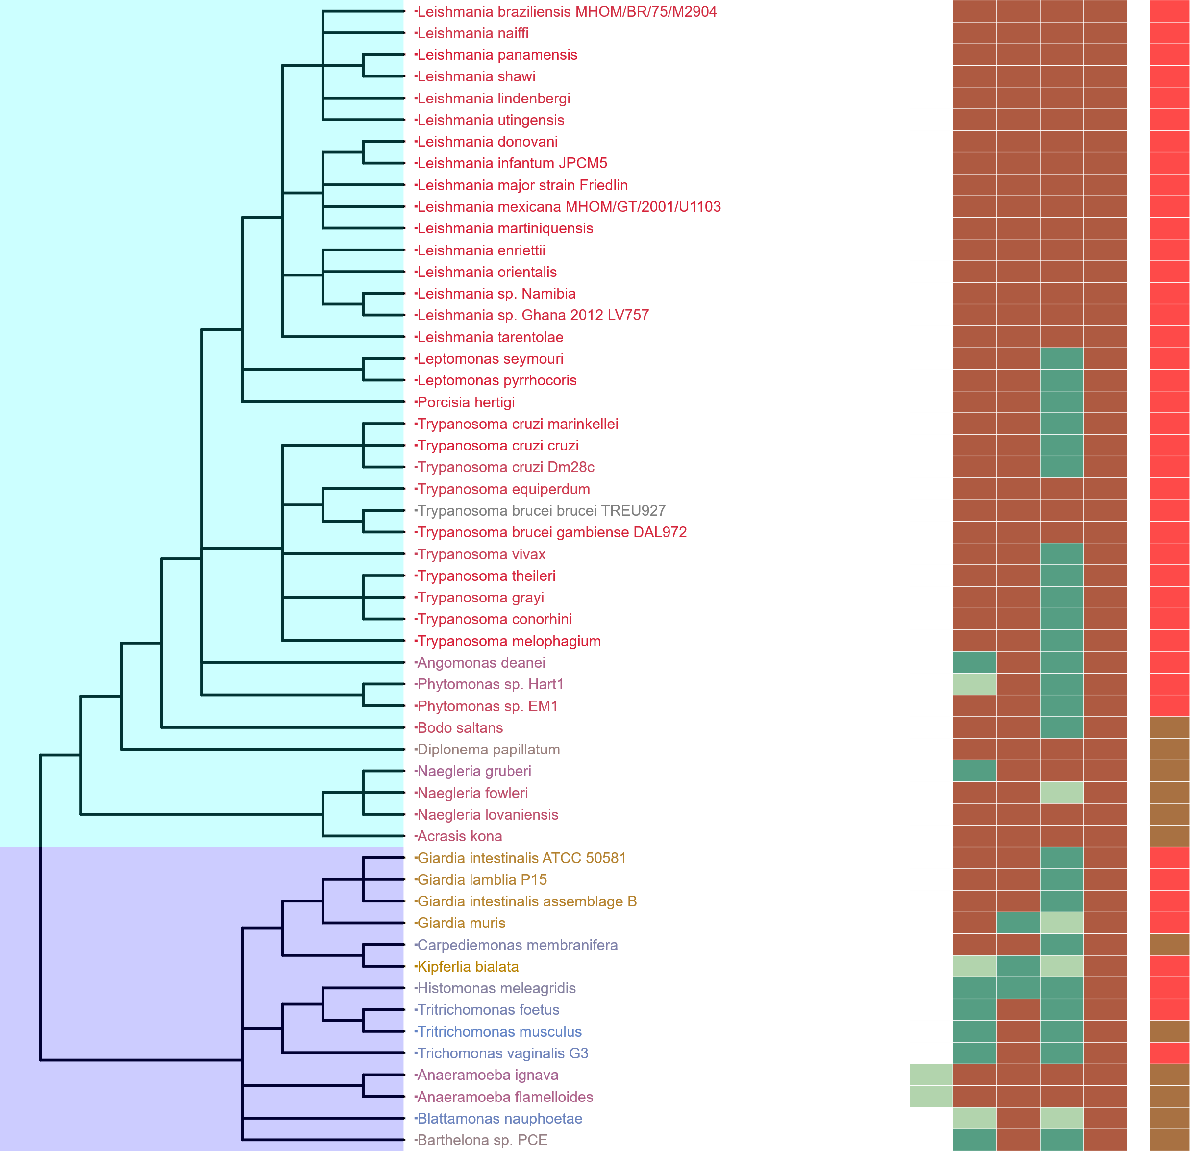
Figure 4
Completeness Score
100
75
50
25
Discoba
HMMER Score
H
M
L
P
ABS
Metabolic Strategy
Autotrophic
Heterotroph
Metamonada
Mixotroph
Plastid Parasite
Non-Plastid Parasite
Endosymbiotic

Slide 5
Figure 5
TORC1
TORC2
Heterotrophic
Mixotrophic
Autotrophic
Non-Plastid Parasites
Plastid
Parasites
Endosymbiotic
Rhodophyta
Archaeplastida
Chlorophyta
TORC1
TORC1
Streptophyta
TORC1 & TORC2
Stramenopiles
LECA
SAR
TORC1
Alveolata
TORC1 & TORC2
TORC2
Rhizaria
Discoba
TORC1 & TORC2
Excavates
TORC1 & TORC2
Metamonada

Slide 6
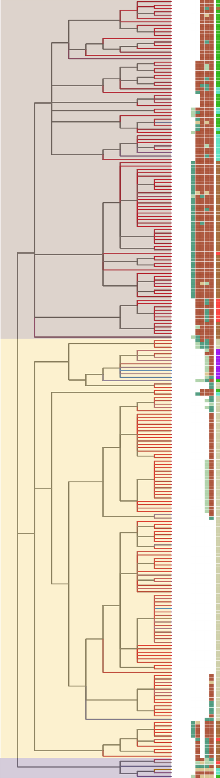

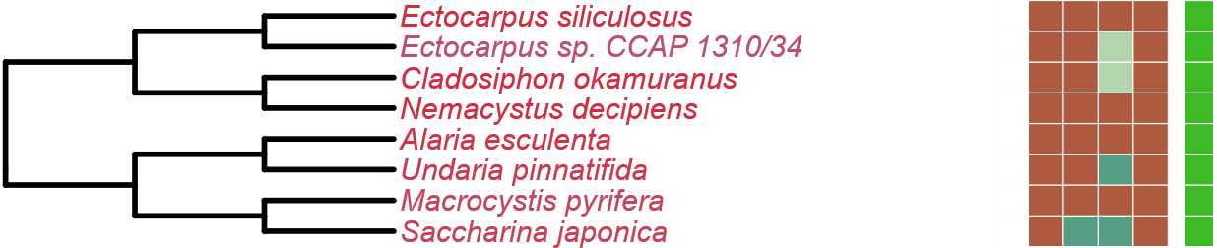

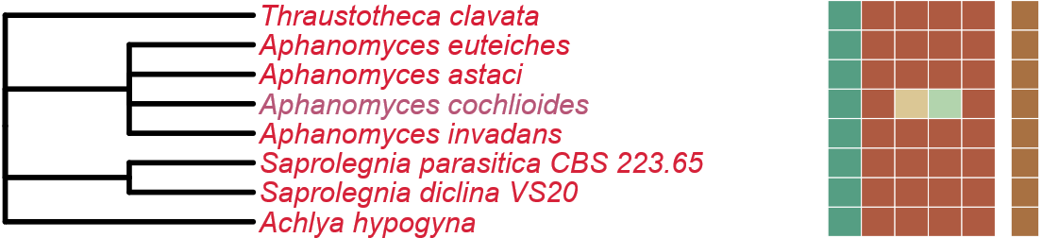

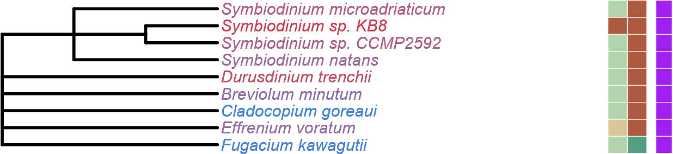


Figure 3
Completeness Score
LST8
100
RICTOR
RAPTOR
SIN1
TOR
75
50
Stramenopiles
25
HMMER Score
H
M
L
P
ABS
Metabolic Strategy
Alveolata
Autotrophic
Heterotroph
Mixotroph
Plastid Parasite
Non-Plastid Parasite
Rhizaria
Endosymbiotic

Slide 7
Figure 3
Completeness Score
LST8
100
RICTOR
RAPTOR
SIN1
TOR
75
50
Stramenopiles
25
HMMER Score
H
M
L
P
ABS
Metabolic Strategy
Alveolata
Autotrophic
Heterotroph
Mixotroph
Plastid Parasite
Non-Plastid Parasite
Rhizaria
Endosymbiotic

Slide 8
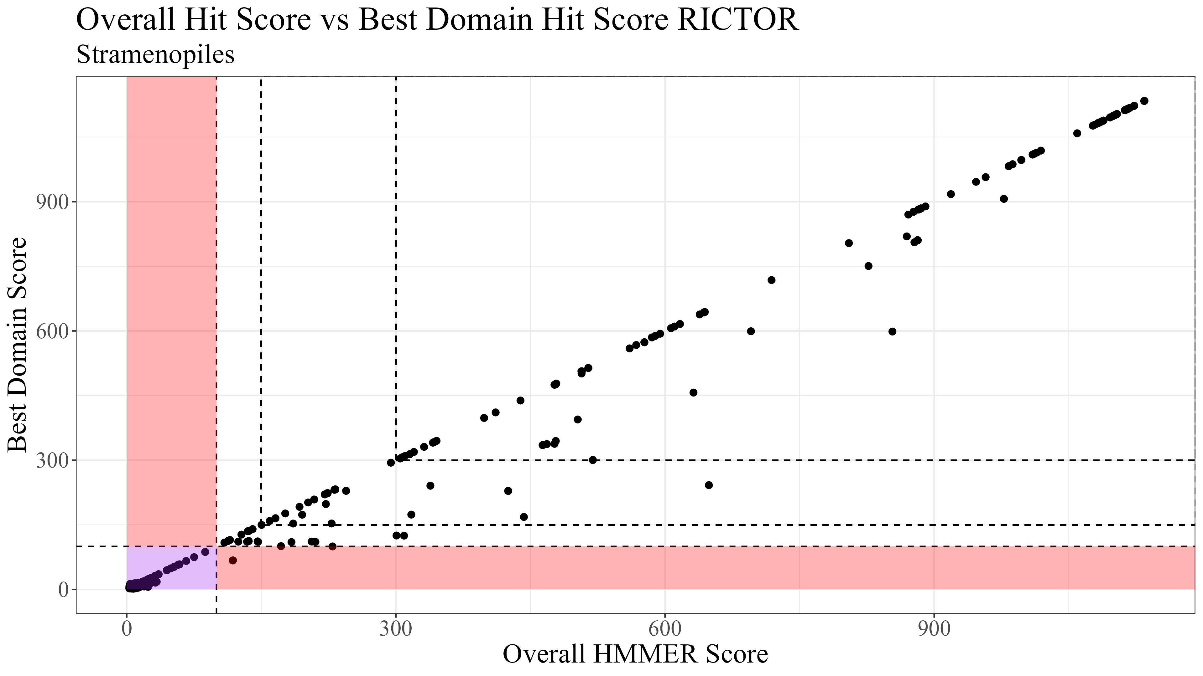
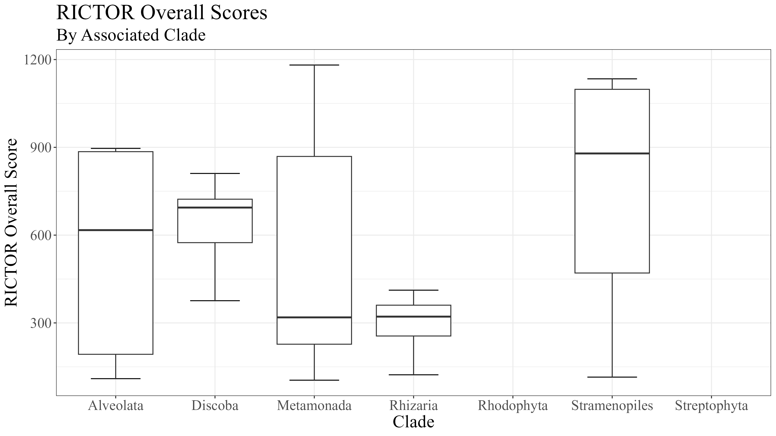
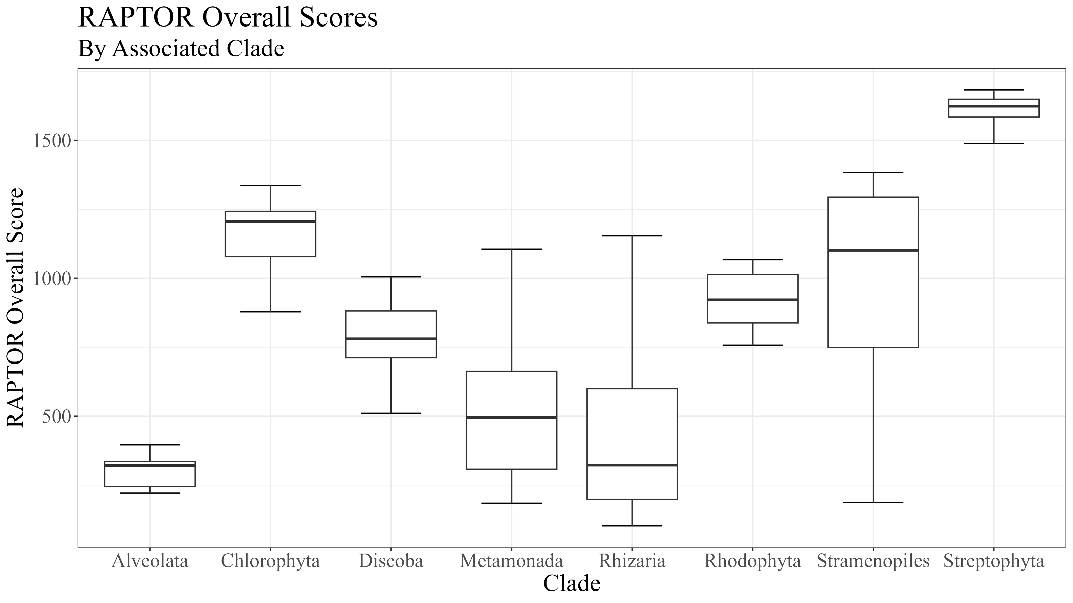
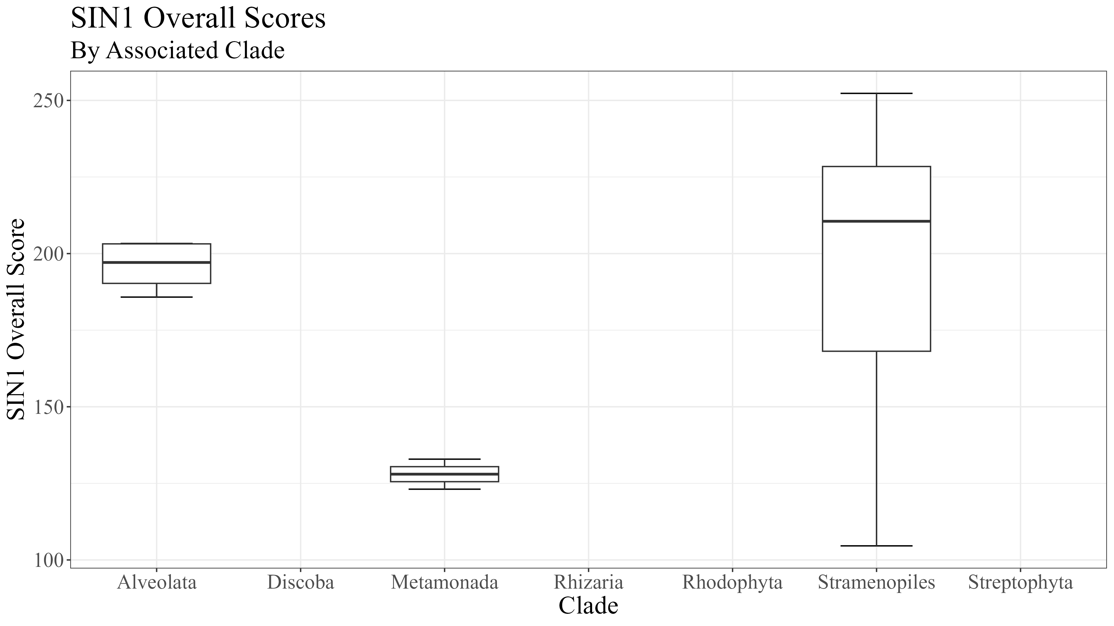
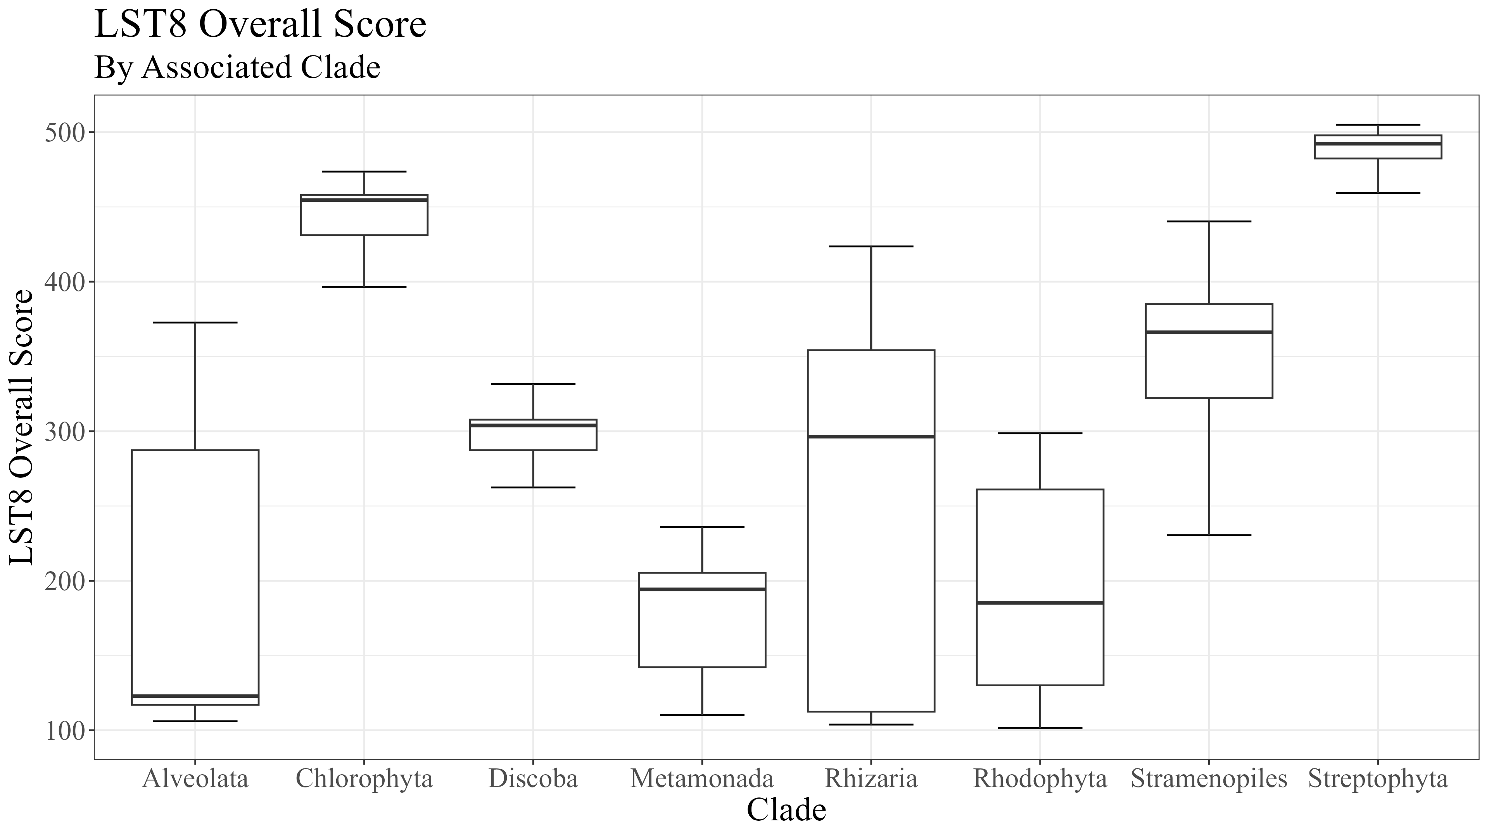
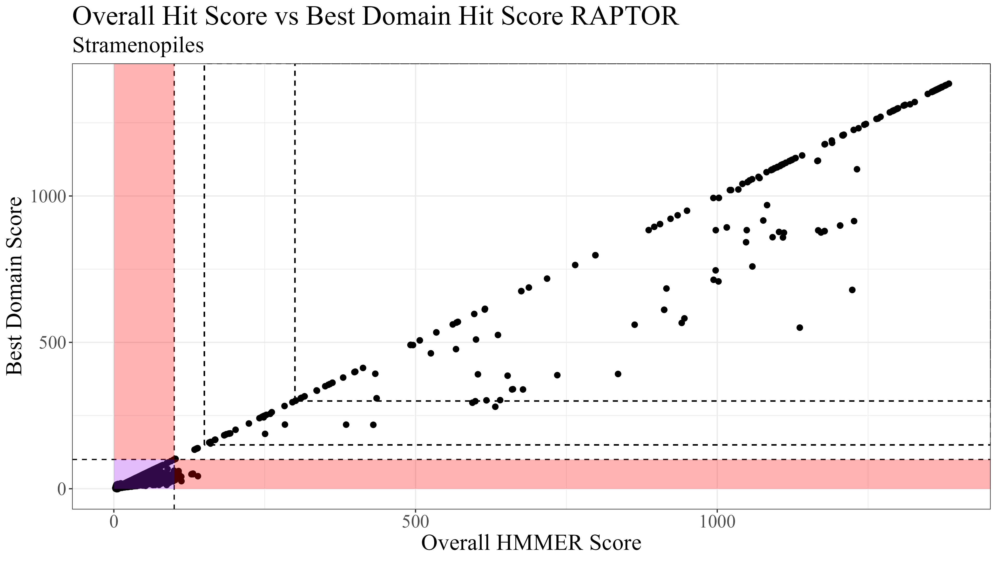
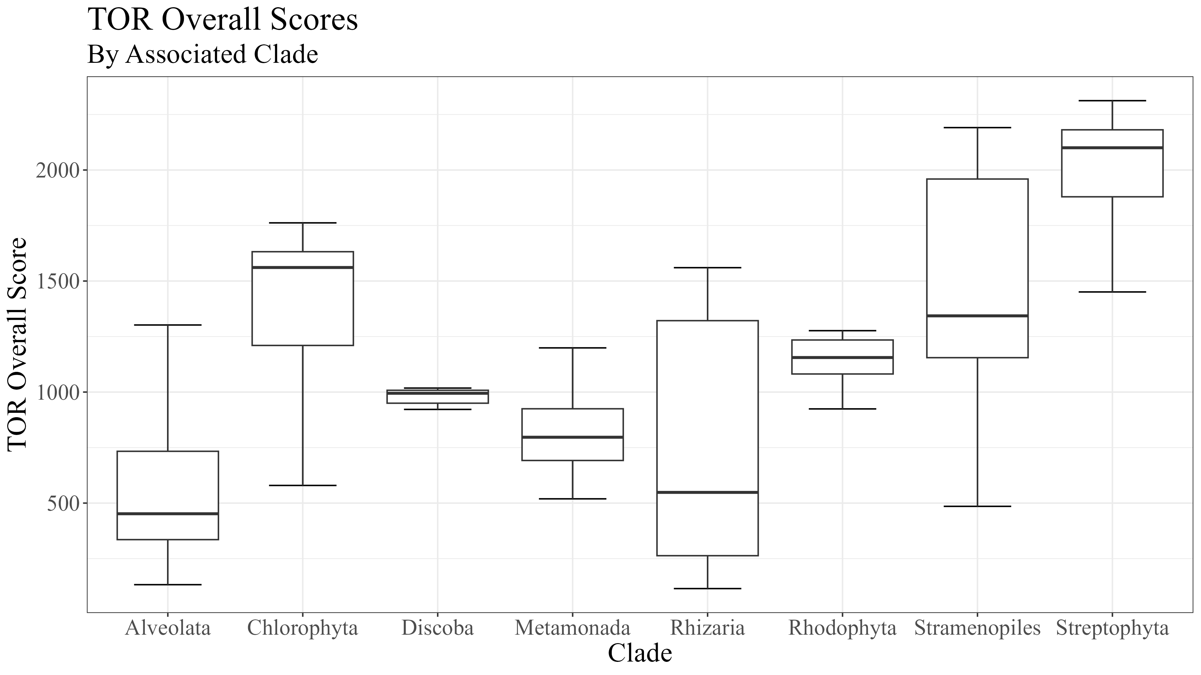
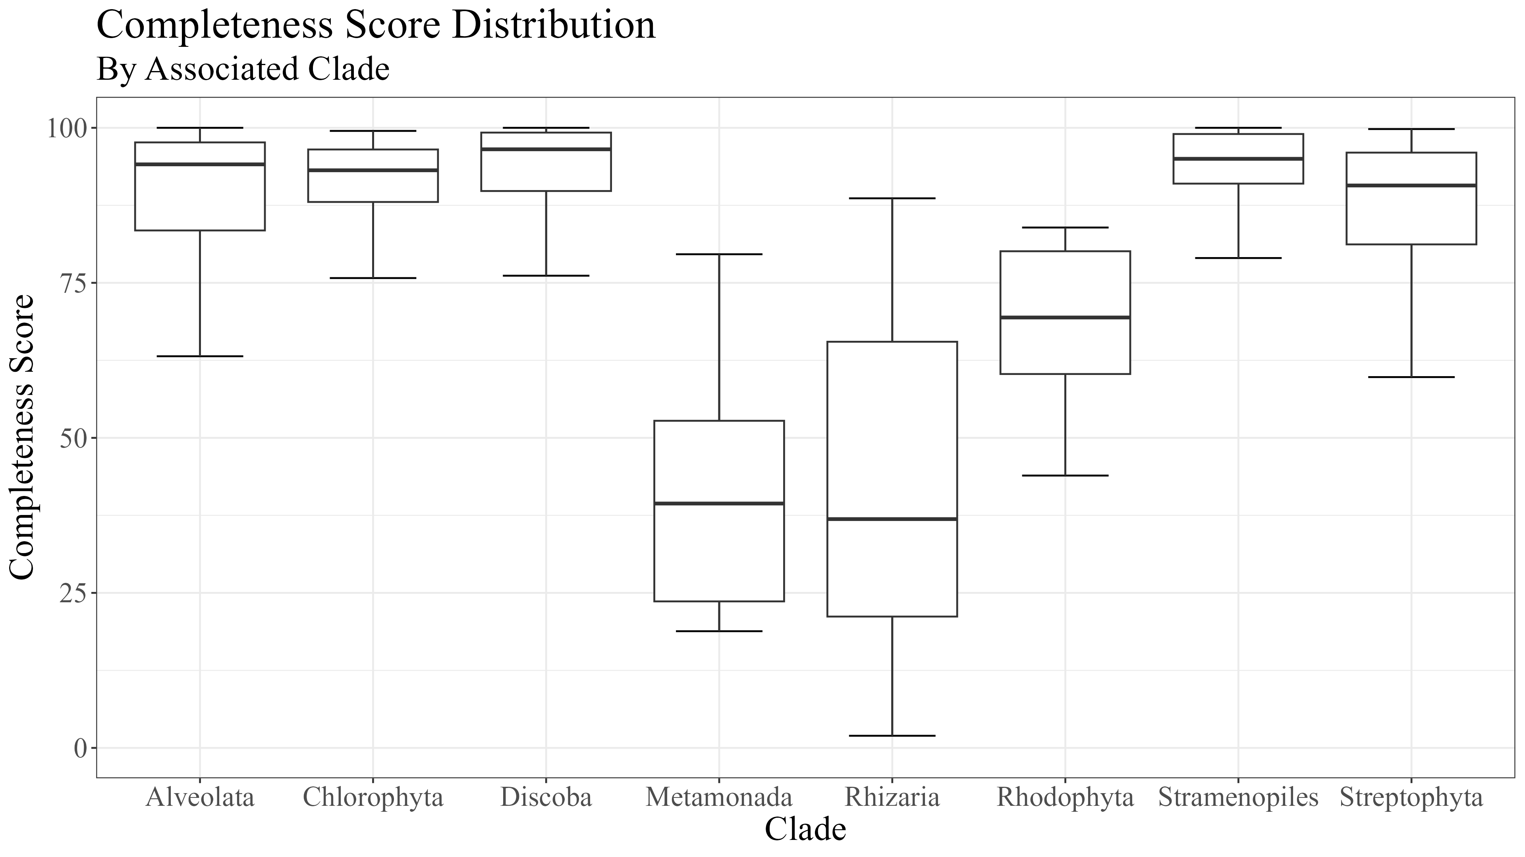
Supplemental 1
Notes:
Supplemental

Slide 9




Supplemental 2
RICTOR
RAPTOR
N
N
RICTORN
RAPTORN
Reference
Reference
High
RICTORM
ARM
High
Medium
RasGEF
HEAT
Low
Medium
Dom5
ARM
Reference
Reference
RICTOR
Phosphor
WD-40
High
High
Medium
Medium
Low
C
C
Notes:
Supplemental

Slide 10
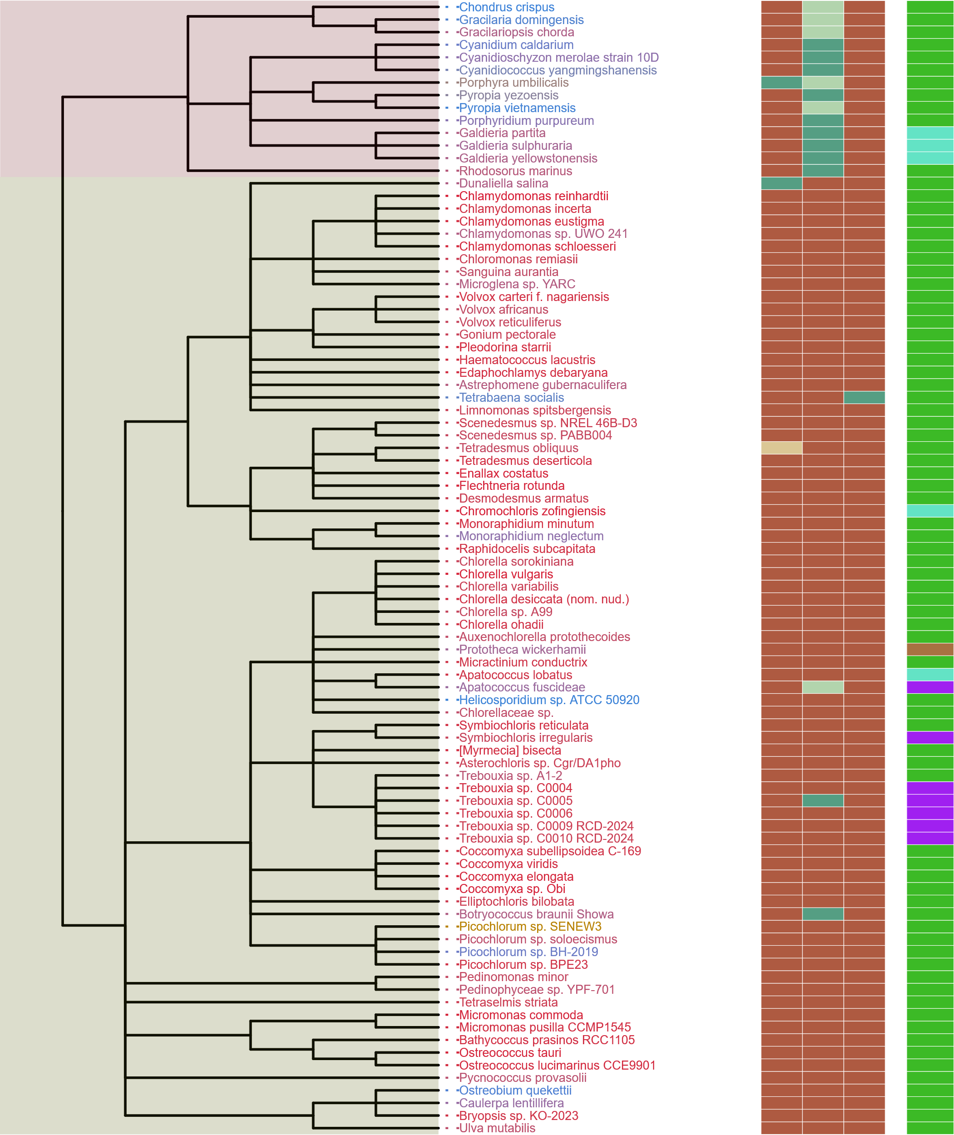
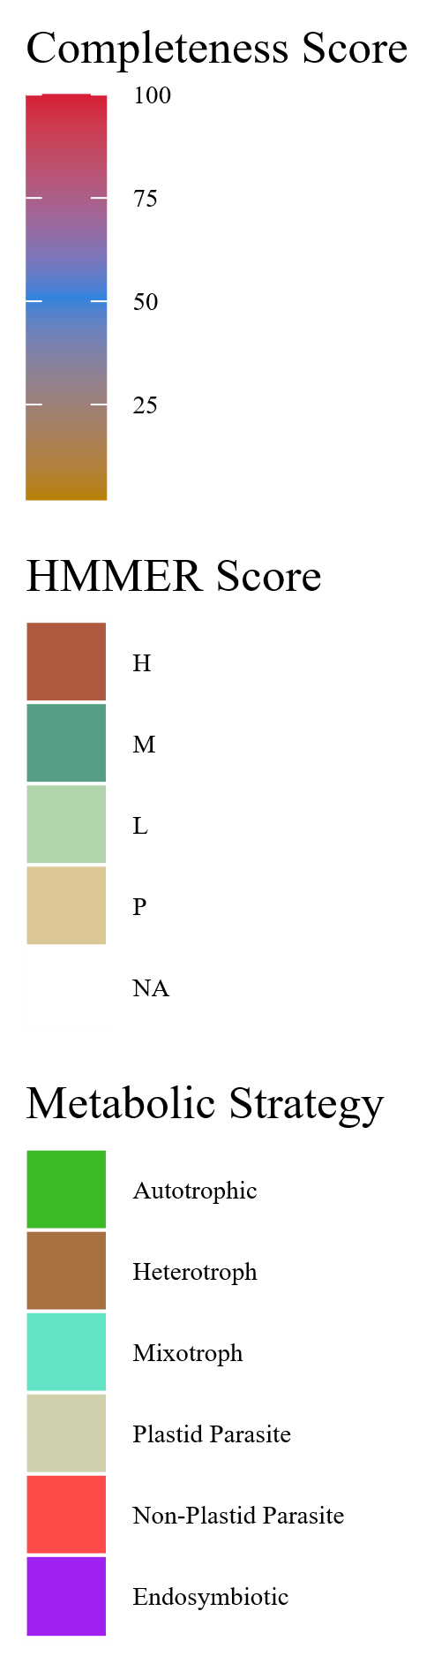
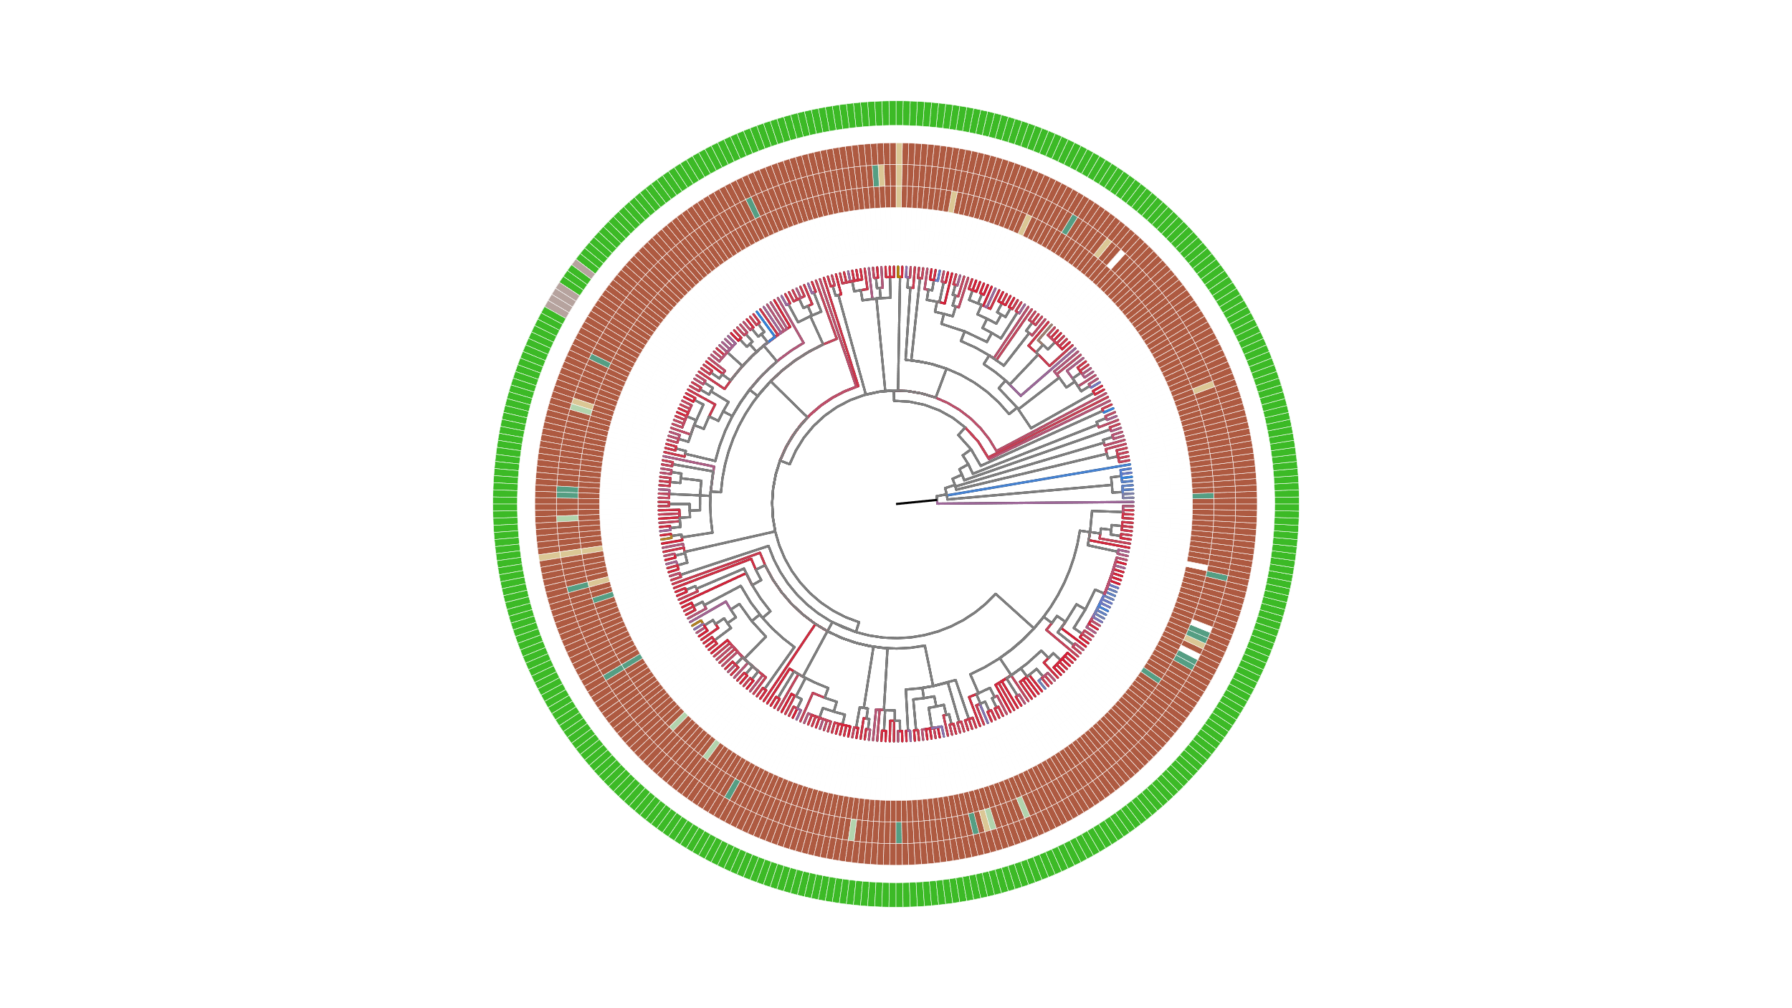
Supplemental 3
SIN1
RICTOR
RAPTOR
LST8
TOR
Streptophyta
Rhodophyta
Chlorophyta

Slide 11
LECA
Excavata
SAR
Archaeplastida
Metamonada
Discoba
Streptophyta
Chlorophyta
Rhodophyta
TORC1 & TORC2
TORC1
Rhizaria
Alveolata
Stramenopila
TORC1
TORC2
Mixotrophic
TORC1
Autotrophic
Heterotrophic
Non-Plastid Parasites
TORC1 & TORC2
TORC2
TORC1
Plastid
Parasites
TORC1 & TORC2
TORC1 & TORC2
Endosymbiotic

Slide 12
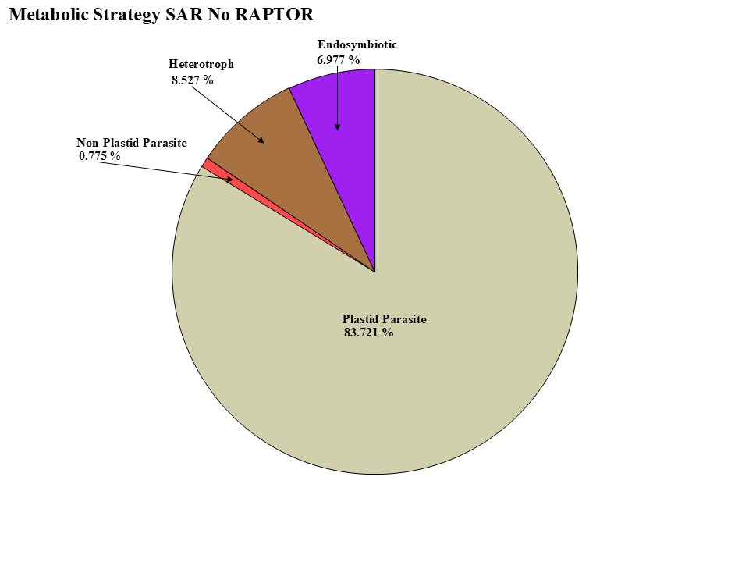
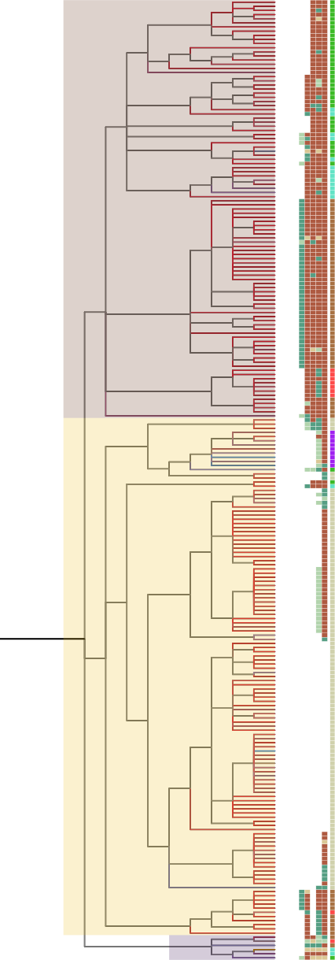
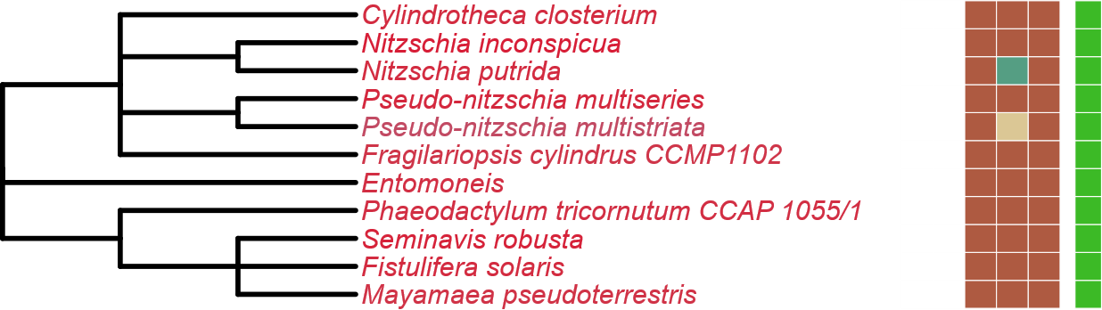
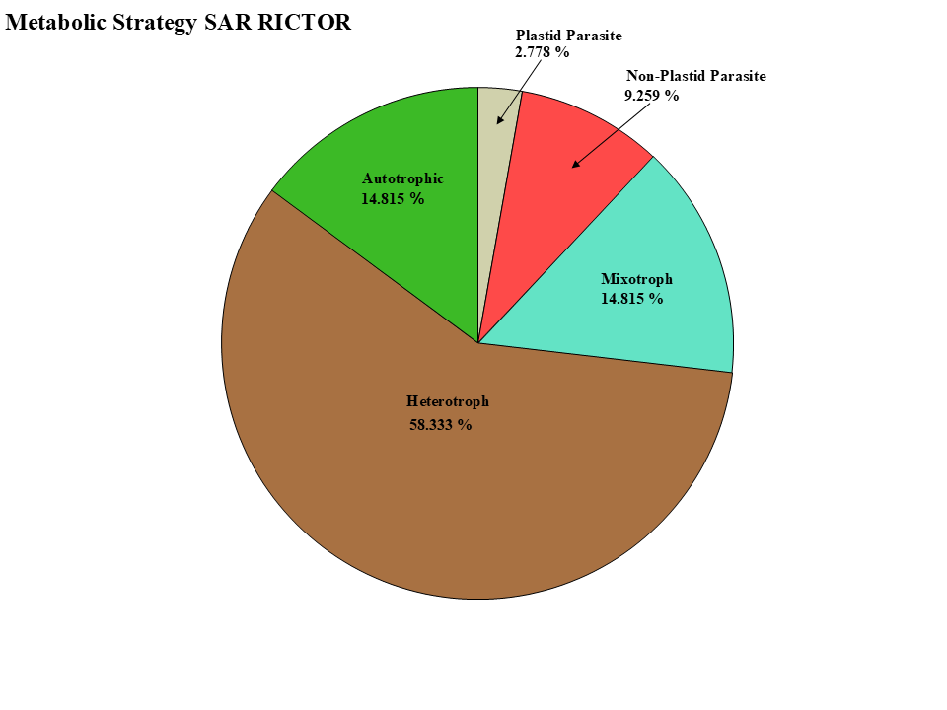
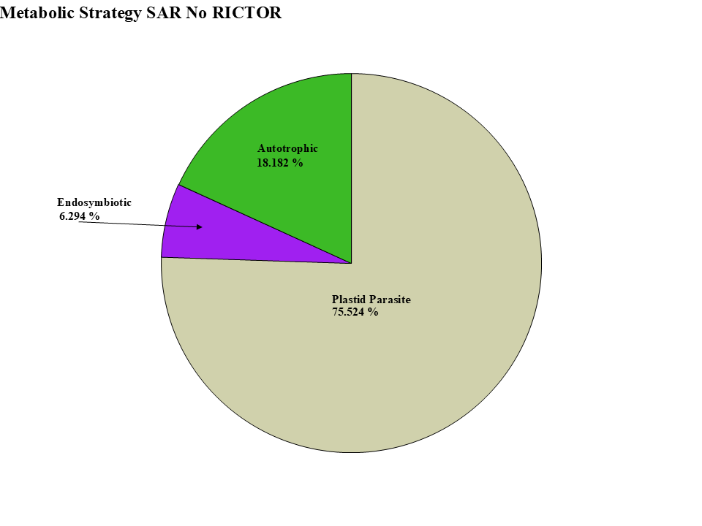
Figure 5
LST8
RICTOR
RAPTOR
SIN1
TOR
Stramenopiles
Alveolata
Rhizaria

Slide 13
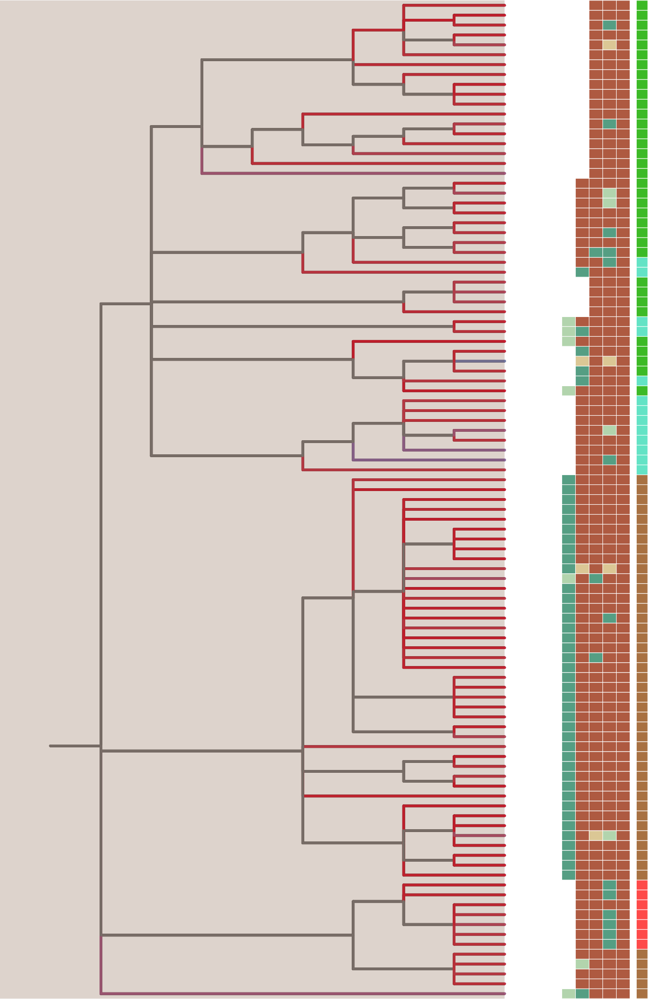
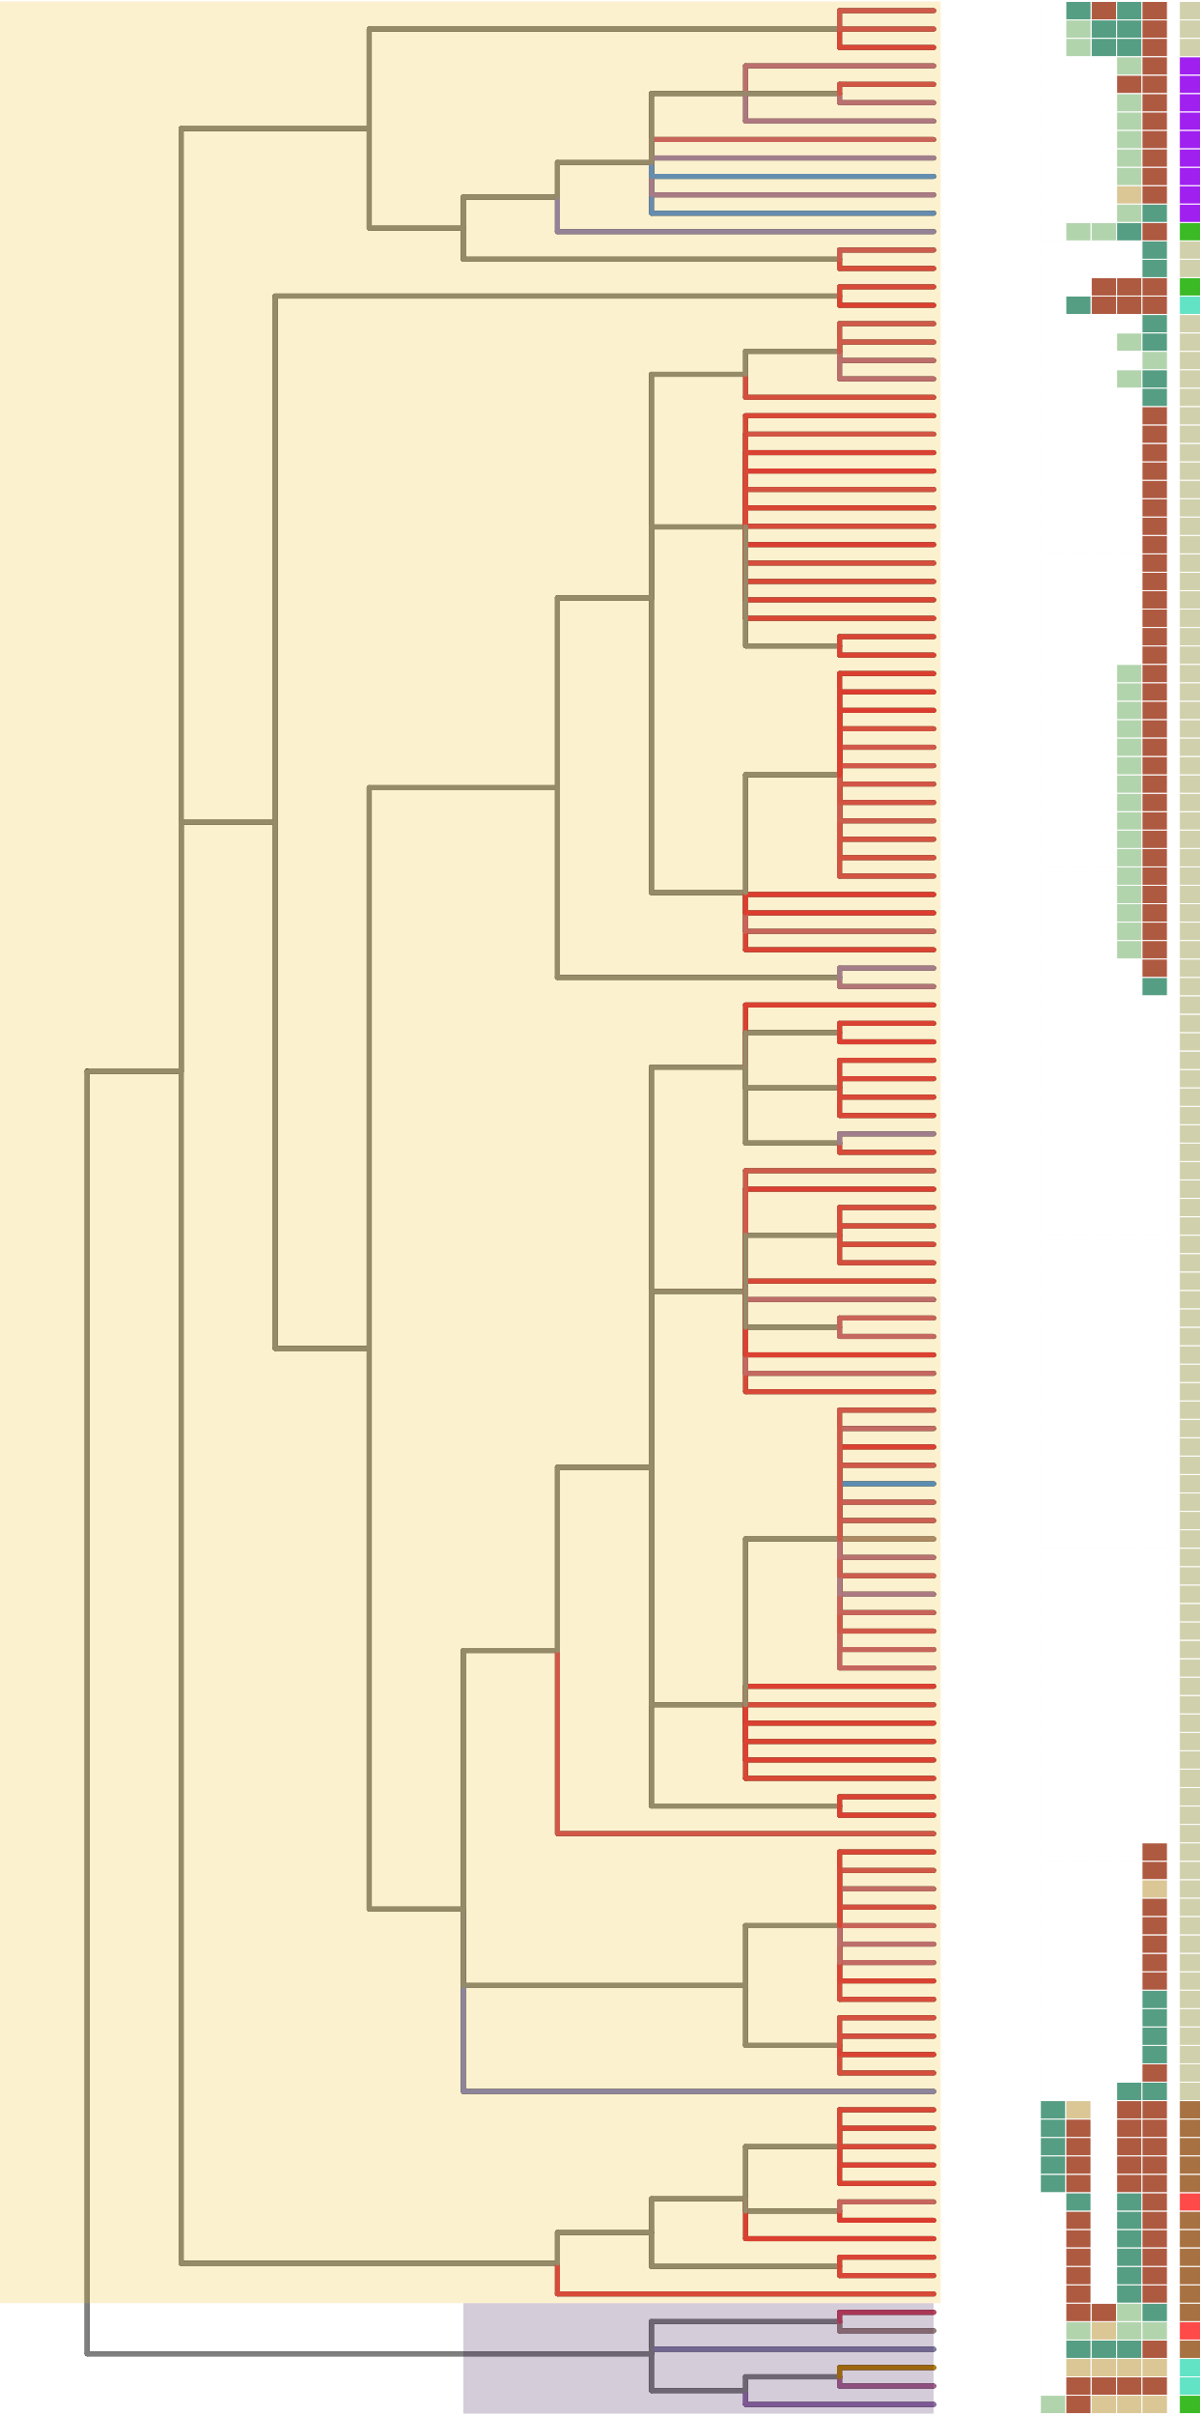



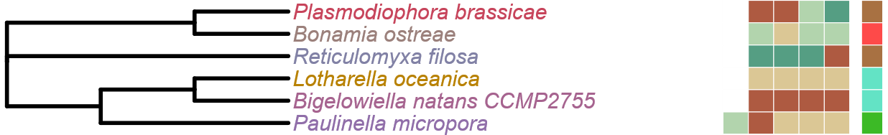
Figure 5
LST8
RICTOR
RAPTOR
Alveolata
Stramenopiles
SIN1
TOR
LST8
RICTOR
RAPTOR
SIN1
TOR
Rhizaria

Slide 14
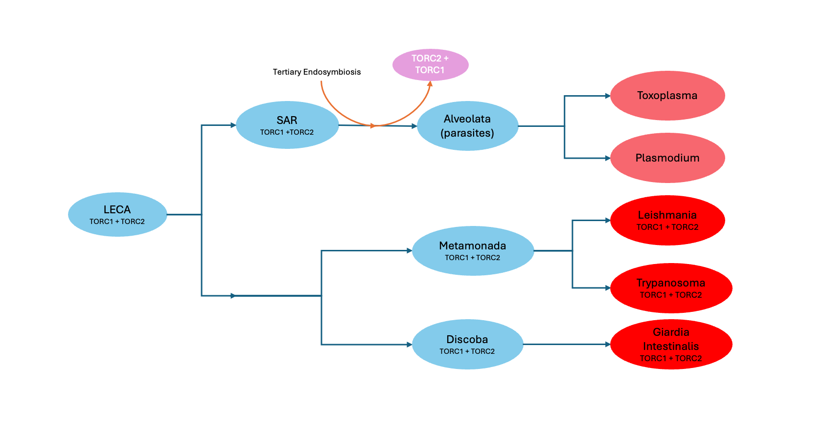

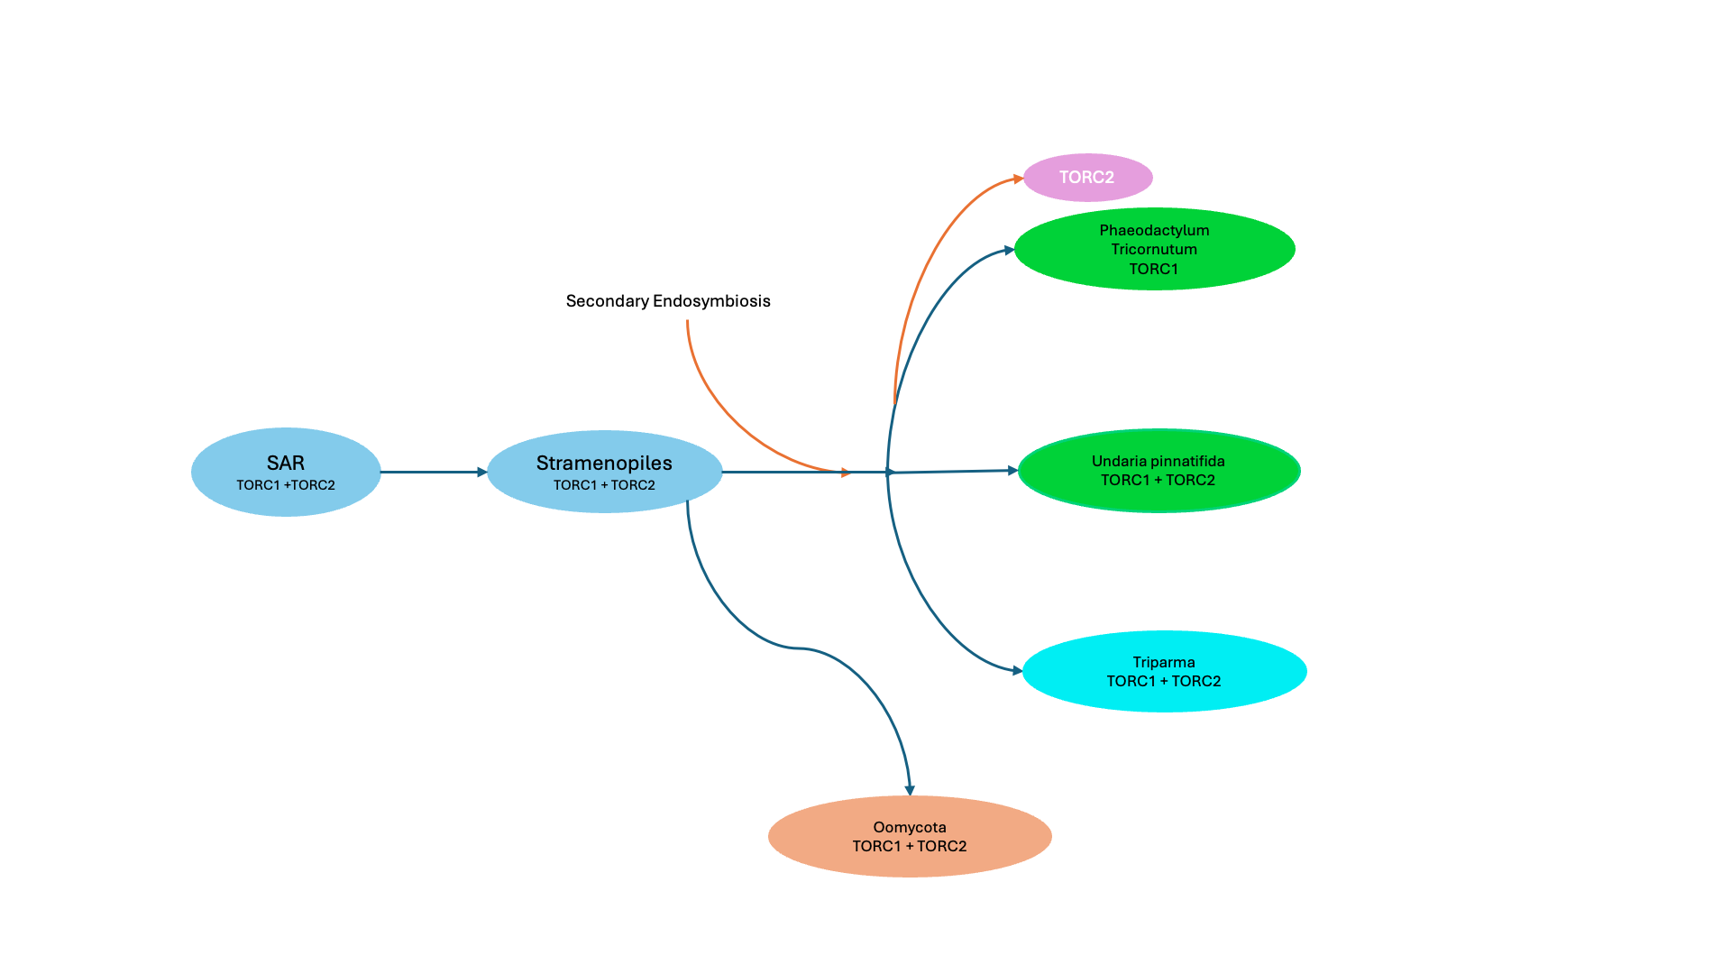

Slide 15
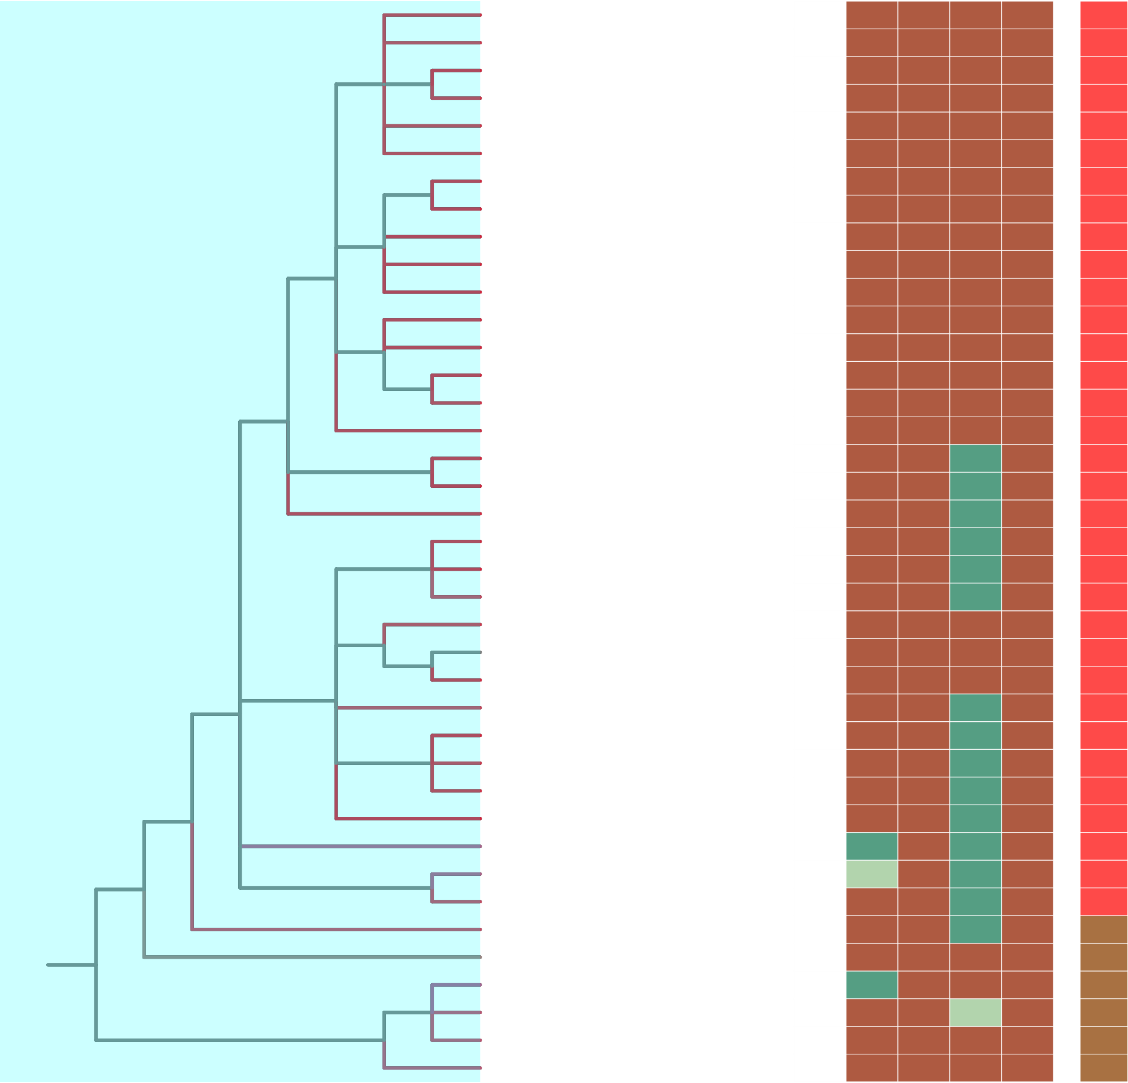
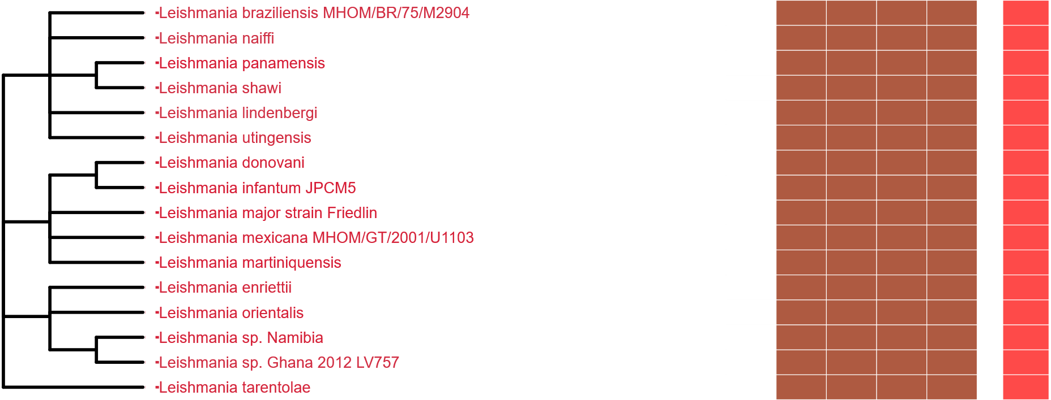
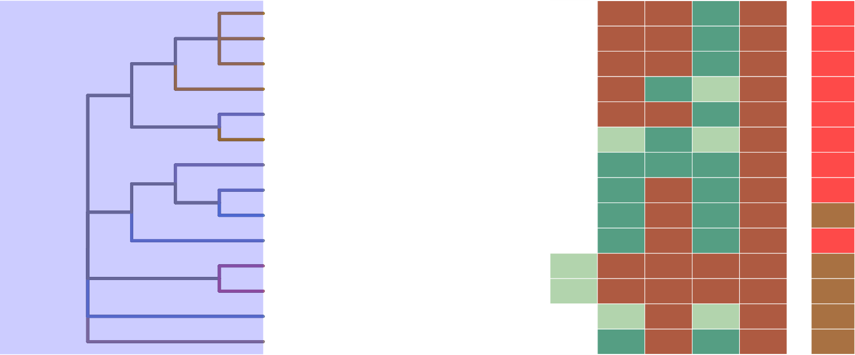
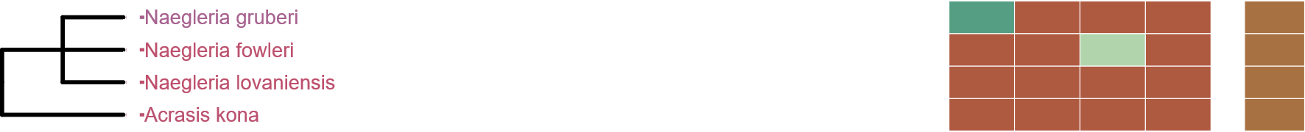
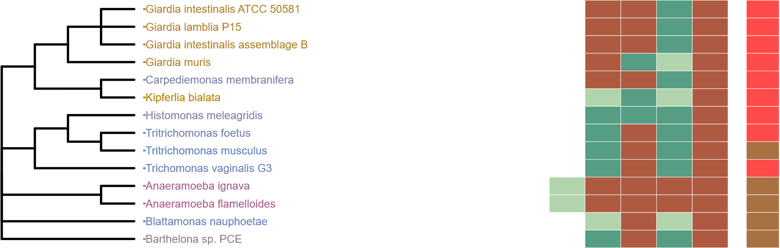
Figure 7
Metabolic Strategy
Metabolic Strategy
Metabolic Strategy
SIN1
RICTOR
RAPTOR
LST8
TOR
SIN1
RICTOR
RAPTOR
SIN1
LST8
RICTOR
RAPTOR
LST8
TOR
TOR
Discoba
Metamonada
Metabolic Strategy
SIN1
RICTOR
RAPTOR
LST8
TOR

Slide 16
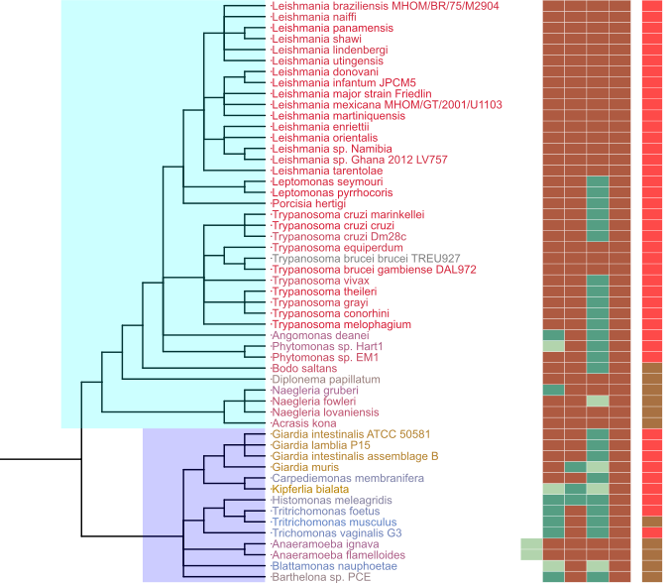
Figure 7
Metabolic Strategy
SIN1
RICTOR
RAPTOR
LST8
TOR
Discoba
TORC2
Archaeplastida
TORC1
LECA
TORC1
TORC2
Excavates
TORC1
TORC2
Discoba
TORC1
TORC2
Metamonada
Metamonada
TORC1
TORC2

Slide 17
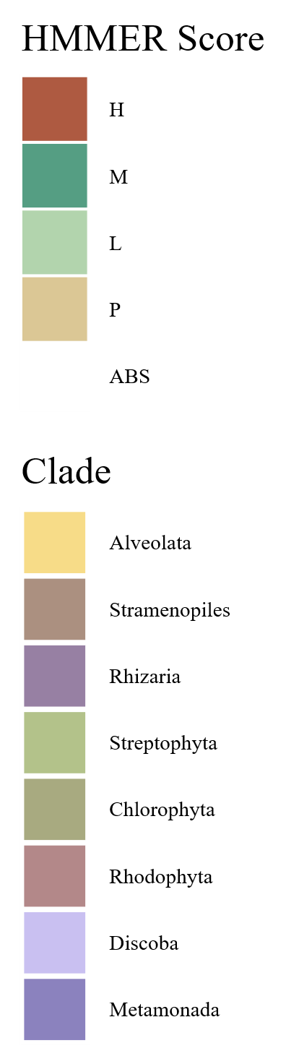
Rhodophyta
TORC2
TORC1
TORC2
Archaeplastida
Chlorophyta
TORC1
TORC1
TORC1
Streptophyta
TORC1
Stramenopila
LECA
TORC1
TORC2
SAR
TORC1
TORC2
TORC1
TORC2
TORC1
TORC2
Alveolata
TORC1
TORC2
TORC1
TORC2
Excavata
Discoba
Rhizaria
TORC1
TORC2
TORC1
TORC2
TORC1
TORC2
TORC1
TORC2
Metamonada
TORC1
TORC2
Notes:
This particular page is a sort of prototype for the last figure. No matter how we slice it though, the exact pathways are rather complicated and take up a lot of room

Slide 18
Figure 6
LECA
TORC1 +TORC2
Primary Endosymbiosis
TORC2
Archaeplastida
TORC1
Chlorophyta
TORC1
Streptophyta
TORC1
Rhodophyta
TORC1

Slide 19
Rhodophyta
Archaeplastida
Chlorophyta
TORC1
TORC1
Streptophyta
TORC1 & TORC2
Stramenopiles
LECA
SAR
TORC1
Alveolata
TORC1 & TORC2
TORC2
Rhizaria
TORC1 & TORC2
Excavates
Discoba
TORC1 & TORC2
Metamonada

Slide 20
Rhodophyta
Archaeplastida
Chlorophyta
TORC1
TORC1
Streptophyta
TORC1 & TORC2
Stramenopiles
LECA
SAR
TORC1
Alveolata
TORC1 & TORC2
TORC2
Rhizaria
Discoba
TORC1 & TORC2
Excavates
TORC1 & TORC2
Metamonada

Slide 21
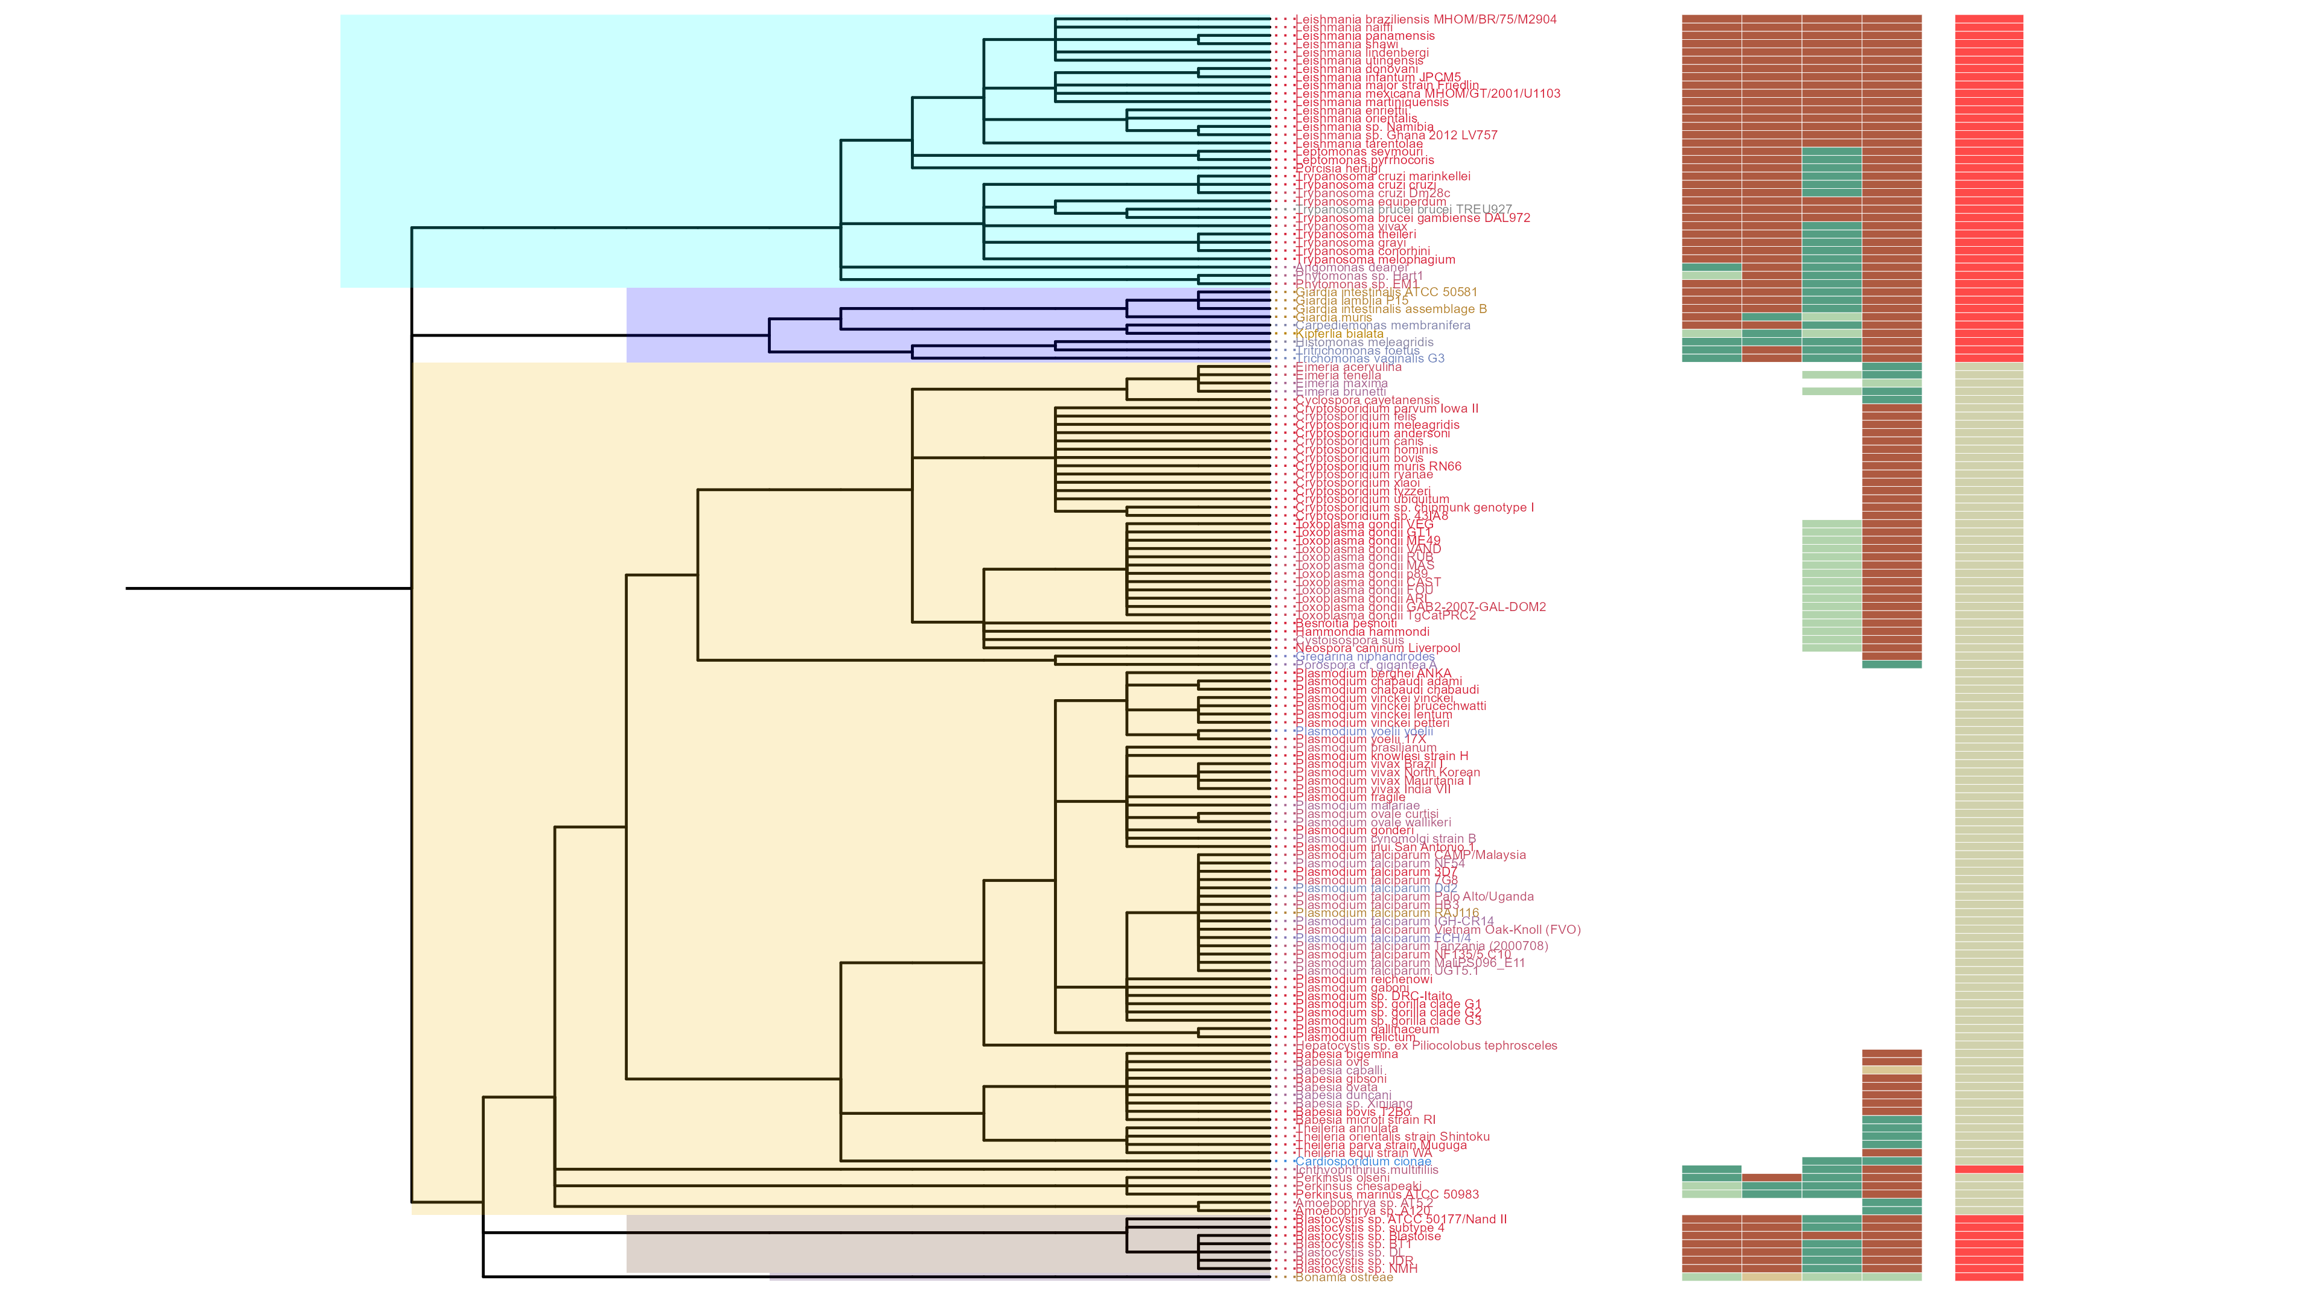
Figure 6
SIN1
RICTOR
RAPTOR
LST8
TOR
Discoba
Metamonada
Alveolata
Rhizaria
Stramenopiles

Slide 23
RICTOR
Color
LECA
Color
RAPTOR
Color
Archaeplastida
Color
Rhodophyta
TORC1
TORC2
Archaeplastida
Chlorophyta
TORC1
TORC1
Streptophyta
LECA
TORC1
TORC1
TORC2
Excavates,SAR,Opisthokonta,etc
TORC1
TORC2

Slide 24
ARCHIVED BELOW

Slide 25
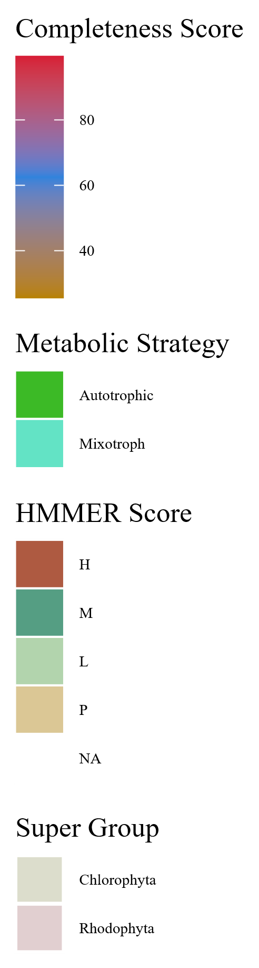

Streptophyta
Metabolic Strategy
SIN1
RICTOR
RAPTOR
LST8
TOR
Rhodophyta
Rhodophyta
TORC2
Chlorophyta
Archaeplastida
Chlorophyta
TORC1
Streptophyta
LECA
TORC1
TORC2
Excavates,SAR,Opisthokonta
TORC1
TORC2
Notes:
Supplemental Archaeplastida

Slide 26




Notes:
Supplemental Possible

Slide 27




Notes:
Supplemental Possible

Slide 28

Notes:
Supplemental Possible

Slide 29


Figure 7
Metabolic Strategy
Metabolic Strategy
SIN1
RICTOR
LST8
RAPTOR
SIN1
TOR
RICTOR
RAPTOR
LST8
TOR
Rhodophyta
Discoba
Chlorophyta
Metamonada

Slide 30
Rhodophyta
TORC1
TORC2
Archaeplastida
Chlorophyta
TORC1
TORC1
Streptophyta
LECA
TORC1
TORC1
TORC2
Excavates,SAR,Opisthokonta,etc
TORC1
TORC2

Slide 31



Figure 6

Slide 32
Figure 1
MSA
Phylogenetic Tree(s)
Final Images,
Pattern Loss Detection
Genome information from NCBI/JGI
BUSCO/HMMER/BLAST
Combined Dataframes
Graphs/Plots/Tables
Trophic Strategy from literature
SRA/DIAMOND

Slide 33

Figure 1

Slide 34






Figure 3
1
RasGEF
Domain5
1694
RICTORN
RICTORM
RICTOR Phosphorylation
Reference
High
Medium
Low
1
HEAT
ARM Repeats
1353
RAPTORN
ARM Repeats
WD-40 Repeats
Reference
High
Medium

Slide 35
Figure 3
1
1694
RICTORN
RICTORM
RasGEF
Domain5
RICTOR Phosphorylation
ARM Repeats
Reference
High
Medium
Low
1
1353
RAPTORN
ARM Repeats
HEAT
ARM Repeats
WD-40 Repeats
Reference
High
Medium

Slide 36






Metabolic Strategy
LST8
RICTOR
RAPTOR
SIN1
TOR
Stramenopiles
Alveolata
Rhizaria

Slide 38


Slide 39




Figure 3
TOR
LST8
RAPTOR
RICTOR
SIN1

Slide 40
Streptophyta
Secondary Endosymbiosis
Rhodophyta
Primary Endosymbiosis
TORC2
Chlorophyta
Chlorarachniales
TORC1 + TORC2
Rhizaria
TORC1 + TORC2
Primary Endosymbiosis
Archaeplastida
TORC1
LECA
TORC1 + TORC2
Paulinella Micropora
TORC1 + TORC2
SAR
TORC1 +TORC2
Secondary Endosymbiosis
TORC2
Stramenopiles TORC1 + TORC2
Brown Algae
TORC1
Secondary Endosymbiosis
Excavates
TORC1 +TORC2
Tertiary Endosymbiosis
TORC2 + TORC1
Eulena Gracilis
TORC1 + TORC2
Alveolata

Slide 41


Figure 7
Metabolic Strategy
SIN1
RICTOR
RAPTOR
LST8
TOR
Discoba
Metamonada

Slide 42



Metabolic Strategy
Streptophyta
SIN1
RICTOR
RAPTOR
LST8
TOR
Rhodophyta
Chlorophyta

Slide 43



Slide 44





Figure 6

Slide 45


Figure 6

Slide 46



Figure 6

Slide 47
Figure 5

Slide 48
Workflow/Pipeline
NCBI/JGI Genomic Information
MSA
Phylogenetic Tree(s)
Results/TOR Complex Patterns
BUSCO/HMMER/BLAST
R Tables & Taxonomy Tables
Graphs/Data Table
SRA /Diamond Alignment
Notes:
We need to add a start point. Have something that asks the question; what organisms have TORC2 Components and TORC1 Components?

Slide 49
SARs Gain of Plastids:
Losses of TOR Complexes
Rhodophyta Endosymbiosis
Phaeodactylum tricornutum
TORC2 Lost
Macrocystis pyrifera
Stramenopila
Nannochloropsis gaditana
Phytophthora sojae
Expected Heterotrophic Ancestor
TORC1 & TORC2 Present
Stramenopile Endosymbiosis
Polarella glaciallis
Vitrella Brassicaformis
Alveolata
Plasmodium falciparum
Tetrahymena thermophila
Alpha-Cyanobacteria Endosymbiosis
Photoautorophy Loss
Paulinella micropora
TORC1 and TORC2 Lost
Bigelowiella natans
TORC1 Lost
Rhizaria
Chlorophyta Endosymbiosis
Plasmodiophora brassicae

Slide 50
Figure 4

Slide 51


Slide 52


Figure 4

Slide 53
Phylo Trees
HMMER
ClustalO
NCBI/JGI
BLAST
Final Images
Patterns of Loss
Dataframe
BUSCO
DIAMOND
Graphs
Metabolism
Literature
Notes:
We need to add a start point. Have something that asks the question; what organisms have TORC2 Components and TORC1 Components?

Slide 54
Simplified Excavata Gain of Plastids
Chlorophyta Endosymbiosis
Euglenophyceae
Discoba
Kinetoplastea
Eutetramitia, etc.
Expected Heterotrophic Ancestor
TORC1 & TORC2 Present
Metamonada

Slide 55


Slide 56

Figure 1
Metamonada
Opisthokonta
Amoebozoa
Discoba
Rhizaria
Streptophyta
Alveolata
Stramenopila
Rhodophyta
Chlorophyta

Slide 57




Figure 7

Slide 58




Slide 59
Figure 3

Slide 60


Slide 61

Figure 3
TOR
LST8
RAPTOR
RICTOR
SIN1

Slide 62








Figure 2

Slide 63
Metabolic Strategy
LST8
RICTOR
RAPTOR
SIN1
TOR
Stramenopiles
Alveolata
Rhizaria

